Slide 1
PMRF Meet 2021
Indian Institute of Technology Guwahati

Slide 2
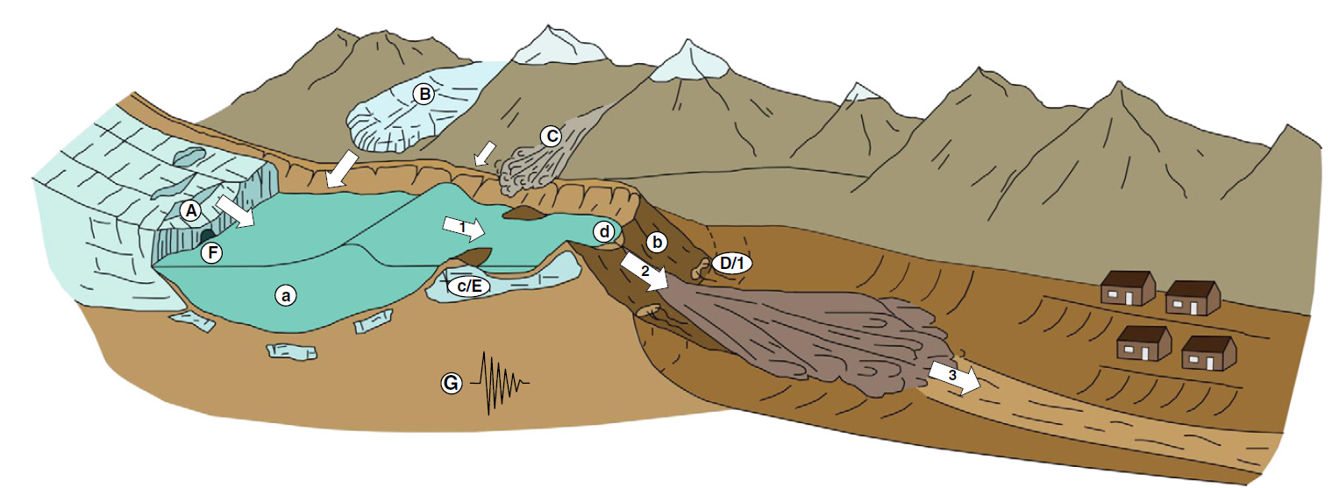
“Quantification of Snow Melt Contribution in Surface Runoff and Subsurface Water using Stable Isotope Study for Brahmaputra River System”
Topic of Research
2
PMRF Meet 2021
November 15, 2021

Slide 3
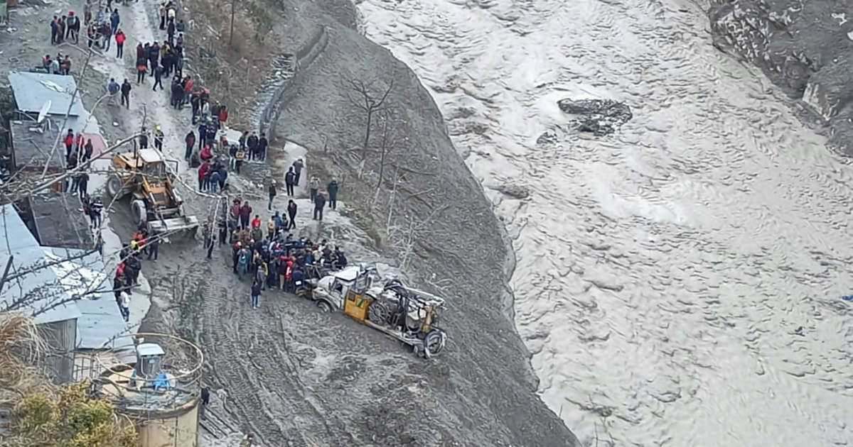
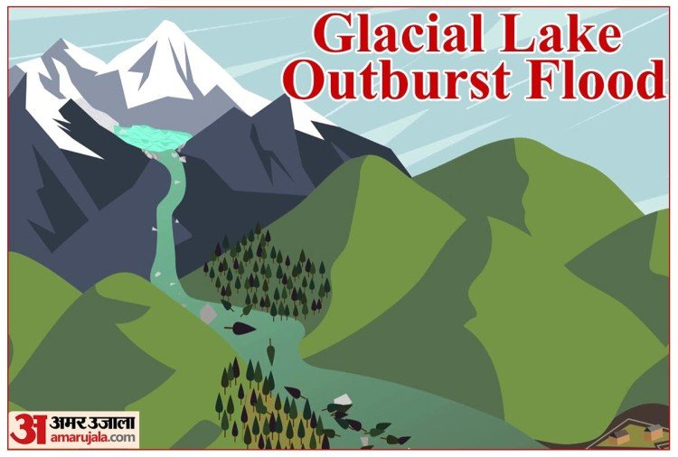
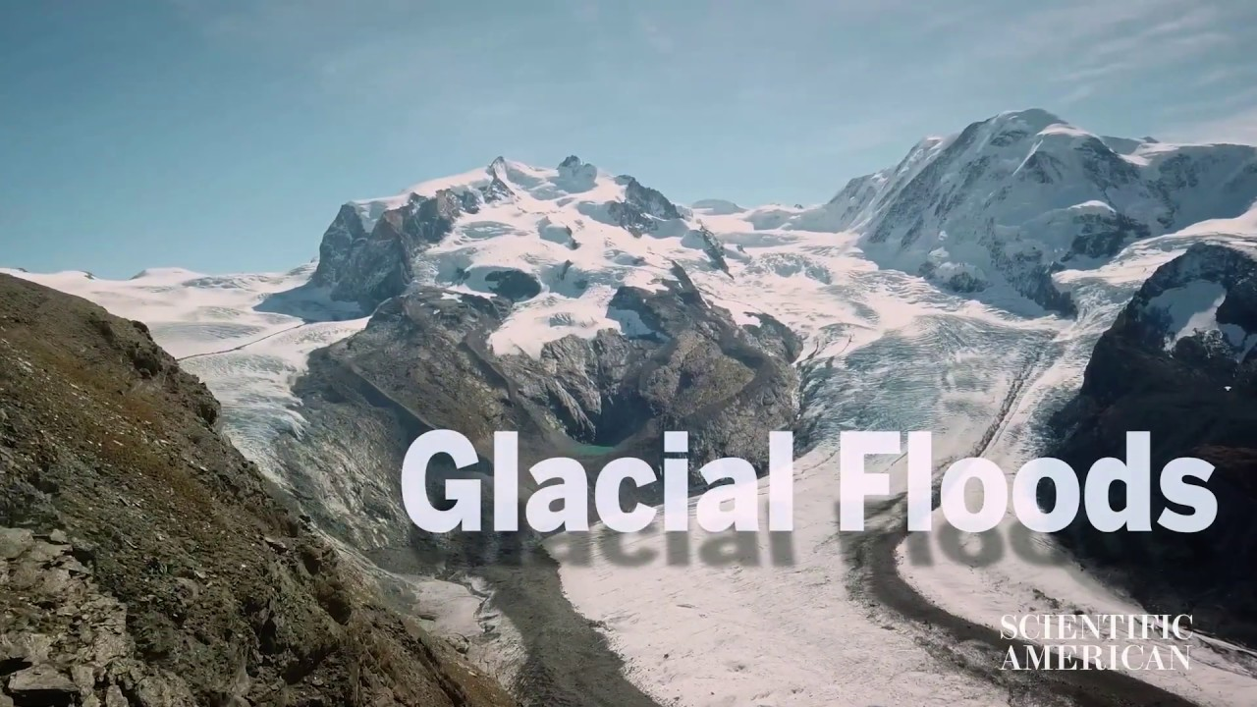

Slide 4
Literature
Boral et al., 20201
Khan et. al., 20174
Wu et al., 20087
“Tracing ‘Third Pole’ ice meltwater contribution to the Himalayan rivers using oxygen and hydrogen isotopes”
The Himalayan cryosphere: A critical assessment and evaluation of glacial melt fraction in the Bhagirathi basin.
“Spatiotemporal Variations of Water Stable Isotope Compositions in Nujiang Headwaters, Qinghai-Tibetan Plateau.”
Gao et al., 20192
Ju et al., 20173
Lambs et al., 20055
“Collapsing glaciers threaten Asia’s water supplies”
“Estimating the contribution of glacial meltwater to Ranwu Lake, a proglacial lake in SE Tibet, using observation data and stable isotopic analyses.”
“Oxygen and hydrogen isotopic composition of major Indian rivers: a first global assessment.”
Sinha et al., 20126
Large river systems of India.

Slide 5
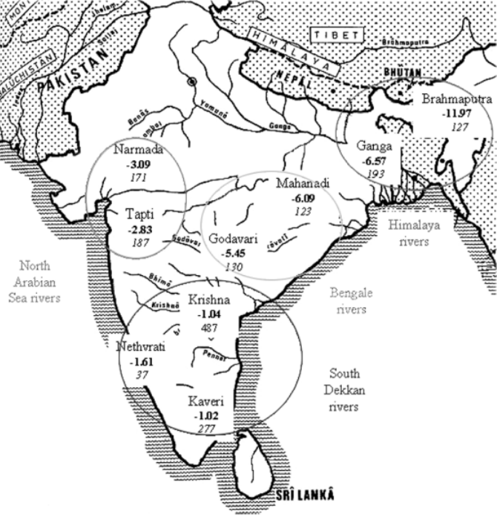
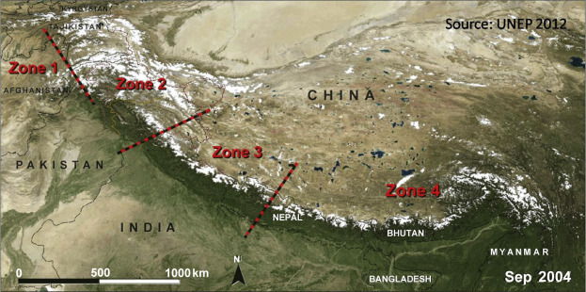
5

Slide 6
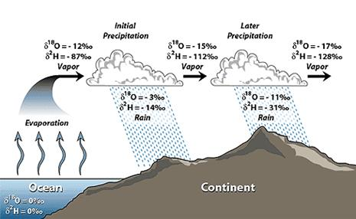
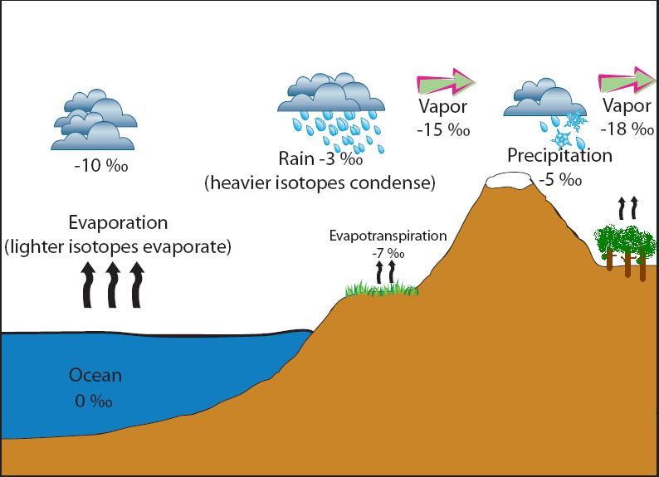
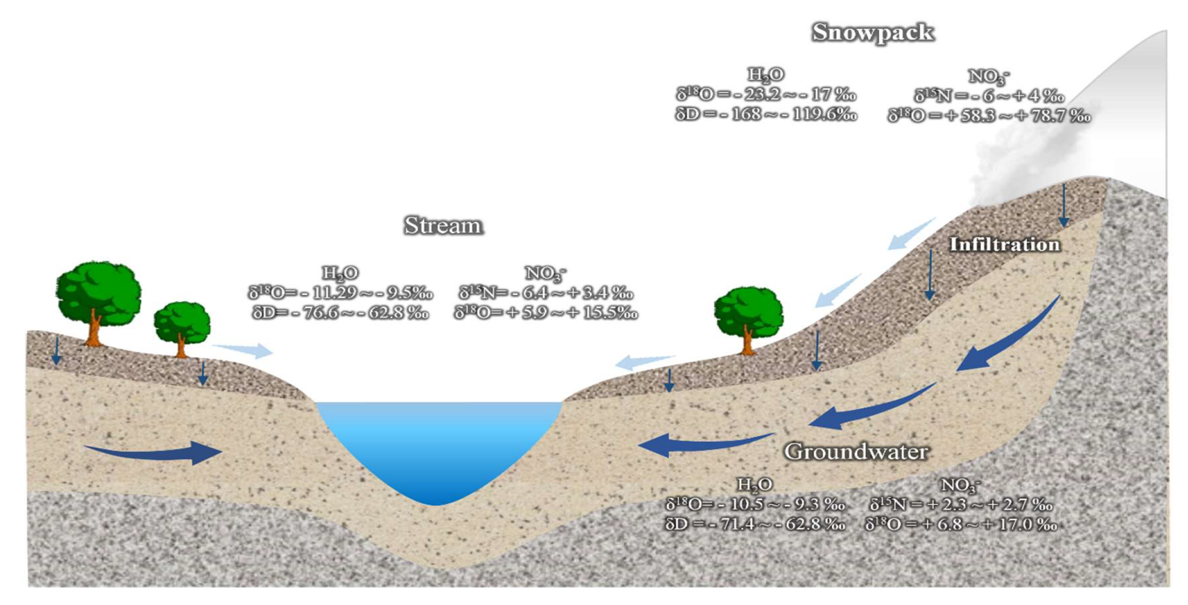

Slide 7
Timeline for next one year
1. Mapping of regional Glacier
2. Literature Review
Tracing of the Regional glacier that contributes to the Brahmaputra river system and locating sampling point.
Tracing of major works done till now in this field.
3. Field work
Seasonal water sample collection from Brahmaputra river.

Slide 8
References
Boral, S. and Sen, I.S., 2020. Tracing ‘Third Pole’ice meltwater contribution to the Himalayan rivers using oxygen and hydrogen isotopes. Geochemical Perspectives Letters, 13, pp.48-53.
Gao, J., Yao, T., Masson-Delmotte, V., Steen-Larsen, H.C. and Wang, W., 2019. Collapsing glaciers threaten Asia’s water supplies.
Ju, J., Zhu, L., Wang, J., Cui, Y., Huang, L., Yang, R., Ma, Q., Luo, L. and Wang, Y., 2017. Estimating the contribution of glacial meltwater to Ranwu Lake, a proglacial lake in SE Tibet, using observation data and stable isotopic analyses. Environmental Earth Sciences, 76(5), p.229.
Khan, A.A., Pant, N.C., Sarkar, A., Tandon, S.K., Thamban, M. and Mahalinganathan, K., 2017. The Himalayan cryosphere: A critical assessment and evaluation of glacial melt fraction in the Bhagirathi basin. Geoscience Frontiers, 8(1), pp.107-115.
Lambs, L., Balakrishna, K., Brunet, F. and Probst, J.L., 2005. Oxygen and hydrogen isotopic composition of major Indian rivers: a first global assessment. Hydrological Processes: An International Journal, 19(17), pp.3345-3355.
Sinha, R.A.J.I.V., Jain, V., Tandon, S.K. and Chakraborty, T.A.P.A.N., 2012, September. Large river systems of India. In Proc. Indian Nat. Sci. Acad (Vol. 78, pp. 277-294).
Wu, H., Wang, X., Shui, H., Ganjurjav, H., Hu, G., Lin, Q., Qin, X. and Gao, Q., 2020. Spatiotemporal Variations of Water Stable Isotope Compositions in Nujiang Headwaters, Qinghai-Tibetan Plateau. Sustainability, 12(16), p.6654.

Slide 9
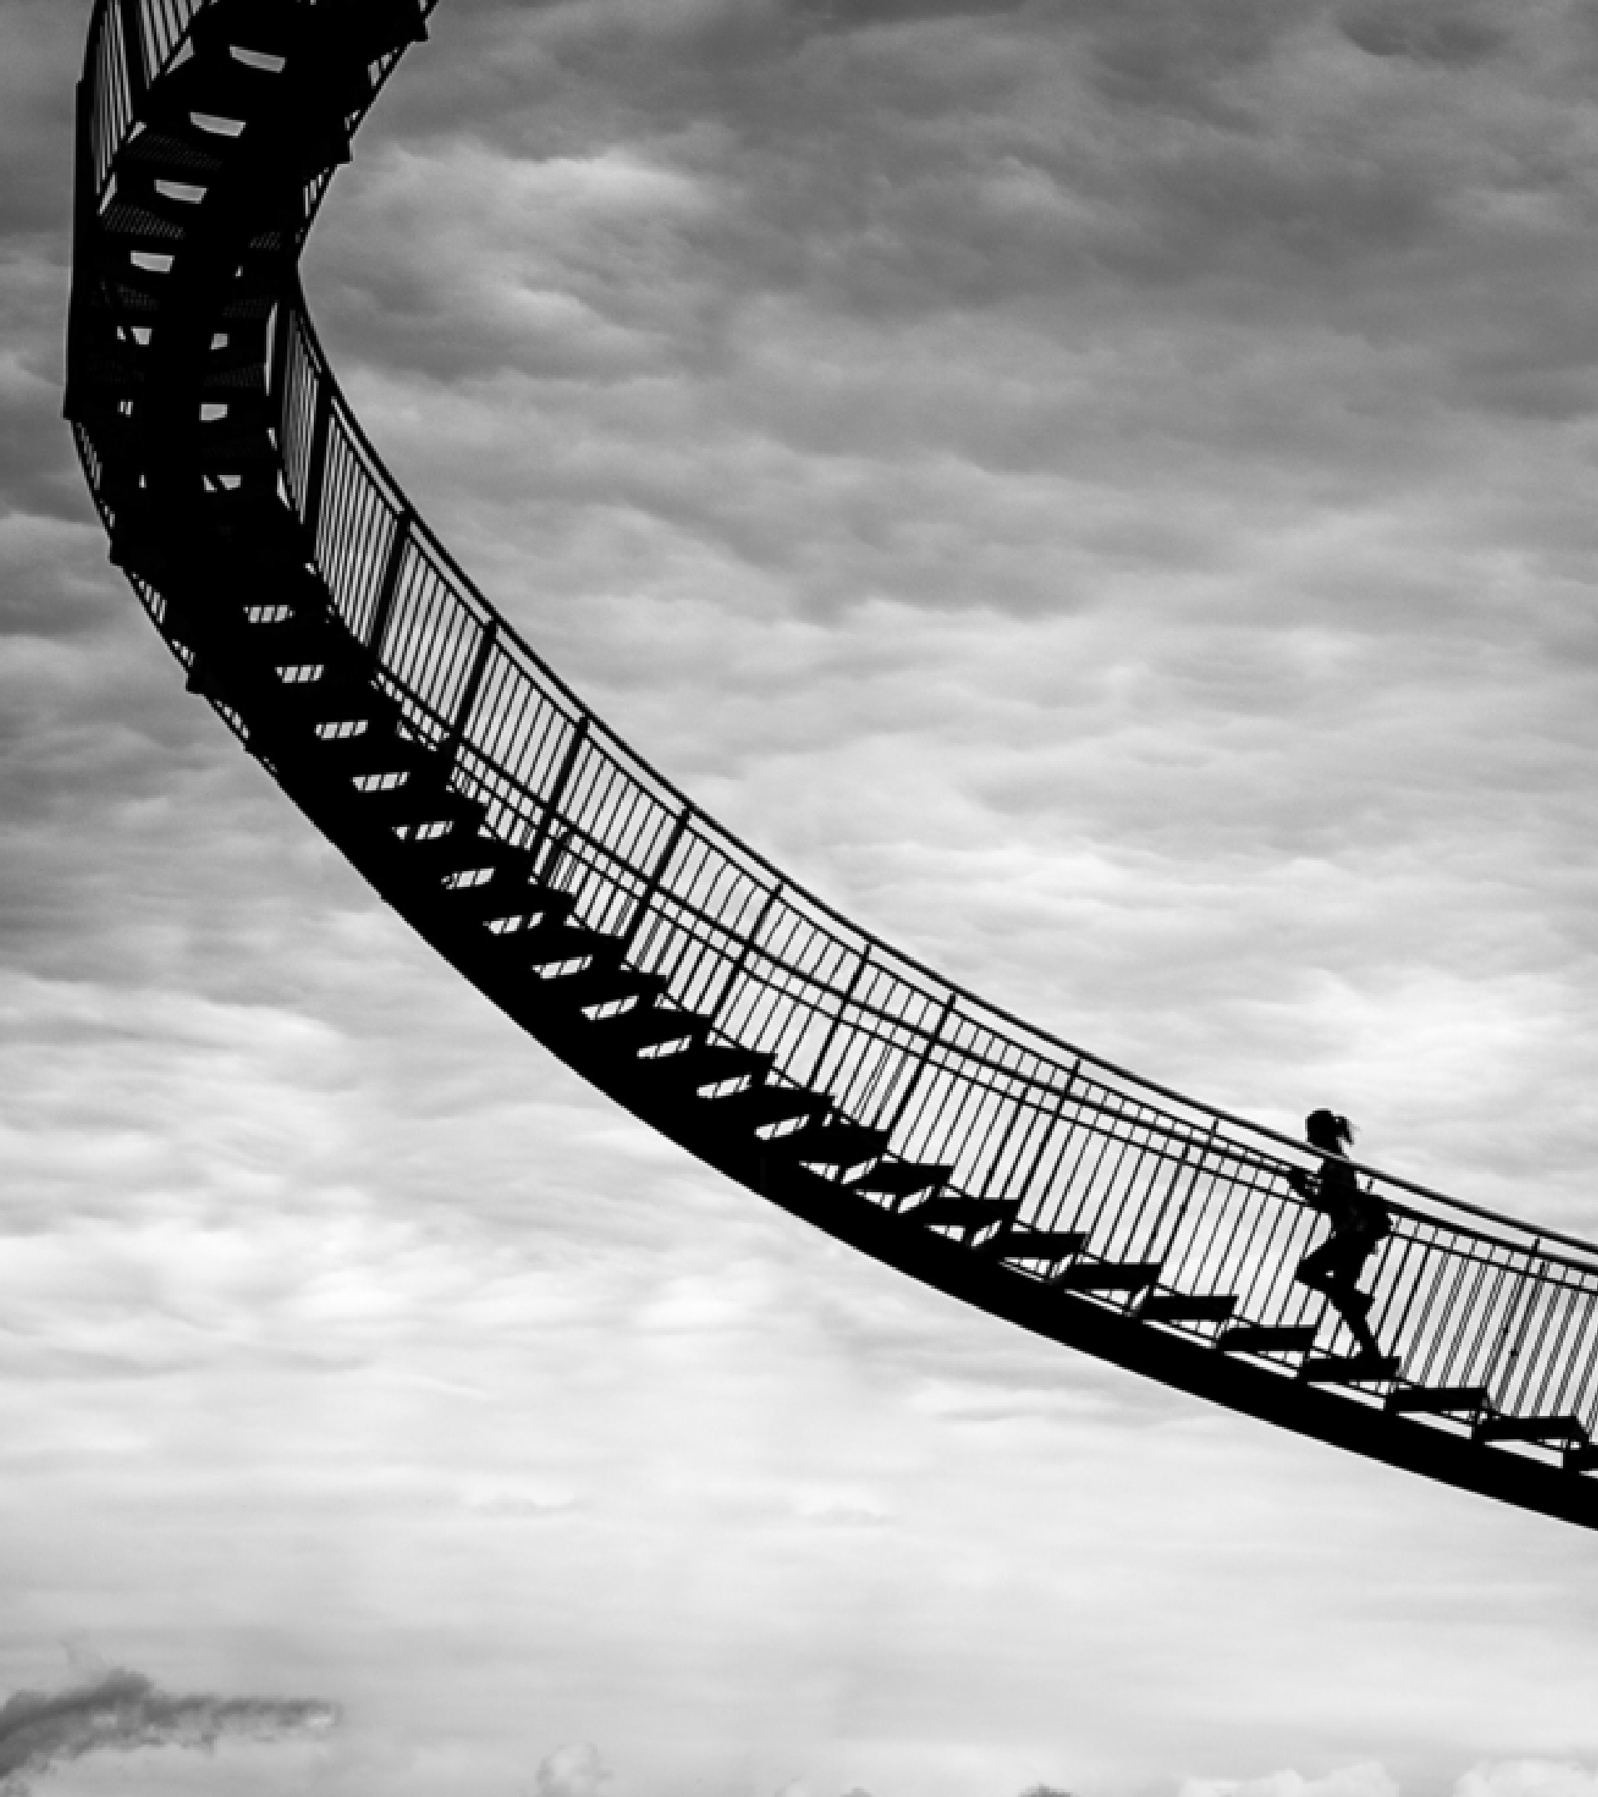
Thank you
Thanks to all for your presence and strong work ethic, we know next year will be even better than the last.
Lets work together to bring new milestone in research.
Madhusmita Nanda
n.madhusmita@iitg.ac.in

