Slide 1
Quantum Mechanics
Soumitra Nandi
PH101, Lec-3

Slide 2

Wave function
De Broglie relations give the frequency and wavelength of some kind of wave to be associated with a particle !
It also makes sense to add together waves of different frequencies !
Based on these assumptions , it is possible to learn a considerable amount
about the waves without actually knowing beforehand what they represent.
The Harmonic Wave Function
Consider a particle of energy E and momentum p, a wave associated with it has the frequency ν and wavelength λ given by the de Broglie relations.
It is more usual to work in terms of the angular frequency ω = 2 ν and wave number k = 2π/λ, so that the de Broglie relations become ω = E/ћ and k = p/ћ
Mathematical form is for a wave
At this stage, we have no idea what the quantity ψ(x,t) represents physically. It is given the name the wave function
ψ(x,t) = A Cos(k x – ωt),
A Sin(k x- ω t)
or A $e^{i\left(k x− ωt\right)}$

Slide 3
Phase velocity
In order to gain an understanding of what a wave function might represent, we will look at what we can learn about a particle if we know what its wave function is.
We are going to look on a wave function as something that gives us information on the particle it is associated with !!
Suppose that the particle has a wave function given by ψ(x,t) = A Cos(k x – ω t)
The phase velocity of the wave is given by $v_{p}= \frac{ω}{k}= \frac{ћω}{ћk}= \frac{E}{P }= \frac{\frac{1}{2} m v^{2}}{m v}=\frac{v}{2}$
Thus, given the frequency and wave number of a wave function, we can determine the speed of the particle from the phase velocity of its wave function.
Velocity with which the constant phase moves in space
However, the wave function above tells us nothing about where the particle is to be found in space !!

Slide 4
Wave packet
A wave function constant throughout all space cannot give information on the position of the particle.
A wave function that did not have the same amplitude throughout all space might be a candidate for giving such information.
A particle is a physical object that is confined to a highly localized region in
space, ideally a point.
We can devise a wave function that is zero or nearly so everywhere in space except for one localized region.
It is in fact possible to construct, from the harmonic wave functions, a wave function which has this property.

Slide 5
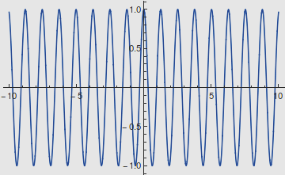
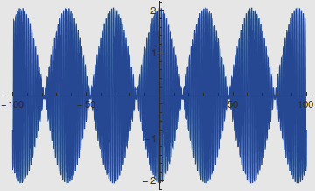
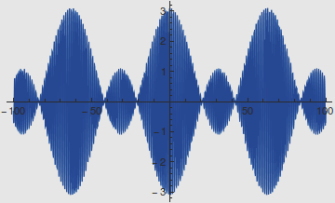
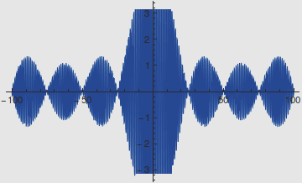
Wave packet: An example
x
x
Cos(5 x)
x
Cos(5 x) + Cos(5.2 x)
Cos(5 x) + Cos(5.1 x) + Cos(5.2 x)
There is only one beat note, all the other beat notes become infinitely far away.
x
x
Cos(5 x) + Cos(5.05 x) + Cos(5.1 x) +Cos(5.15 x) + Cos(5.2 x)
An integral over a continuous range of wave numbers produces a single wave packet.

Slide 6
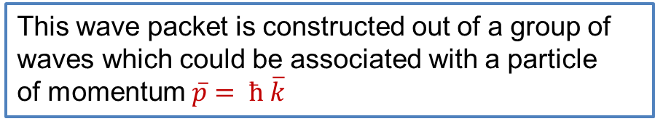
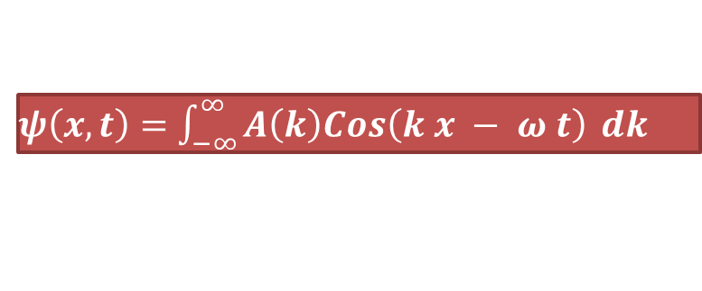
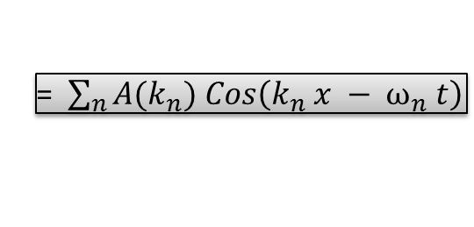

Wave packet: Mathematical detail
Suppose we add together a large number of harmonic waves with wave numbers k₁, k₂, k₃, ……. and $\overline{k} −∆k ≤k_{n} ≤ \overline{k} + ∆k$ around the value !
$$\overline{k}$$
$$ψ\left(x,t\right)=A\left(k_{1}\right)Cos\left( k_{1 }x−ω_{1} t)+A(k_{2}) Cos\left(k_{2 }x−ω_{2}t\right)+A(k_{3}\right)Cos\left(k_{3}x−ω_{3}t\right)+…$$
= $\sum_{n}{A{(k}_{n}) Cos\left(k_{n} x − ω_{n} t\right)}$
In the limit in which the sum becomes an integral:
$ψ\left(x,t\right)=$ $\int_{−∞}^{∞}{A\left(k\right)Cos\left(k x − ω t\right)} dk$
The wave packet is found to have essentially zero amplitude everywhere except over a region of width 2 ∆x .
This wave packet is constructed out of a group of waves which could be associated with a particle
of momentum $\overline{p}= ћ \overline{k}$

Slide 7
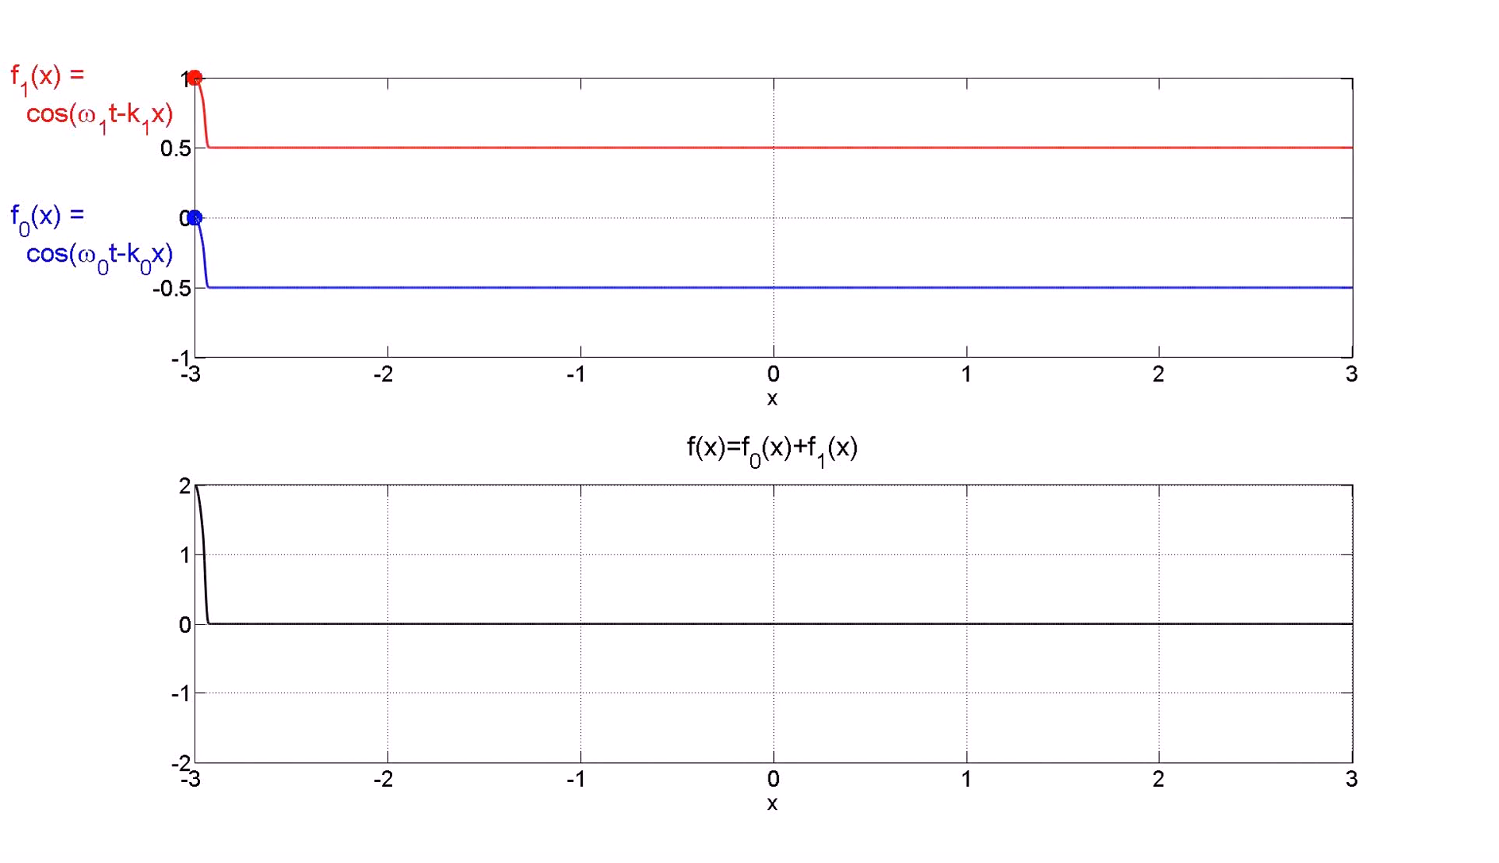
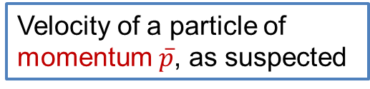
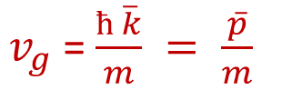


Group velocity
Because a wave packet is made up of individual waves which themselves are moving, though not with the same speed, the wave packet itself will move !
The speed of the wave packet is given by its group velocity v_{g} !
It is the speed of the point on the wave packet where all the waves are in phase !
$v_{g}$ = ${\text{(}\frac{dω}{dk})}_{k= \overline{k}}$
Consider a non relativistic electron of mass m , it’s kinetic energy is E = ½ m v²
De Broglie relations !
ћω = $\frac{ћ^{2 }k^{2}}{2m}$
$v_{g}$ = $\frac{ћ \overline{k}}{m} = \frac{\overline{p}}{m}$
Velocity of a particle of momentum $\overline{p}$, as suspected

Slide 8




Uncertainty relation
The wave packet constructed in the previous section obviously has properties that are reminiscent of a particle, but it is not entirely particle-like !
The wave function is non-zero over a region in space of size 2∆x.
It is intuitively appealing to suppose that where ψ(x,t) has its greatest amplitude the particle is most likely to be found there !
We have seen that to construct this wave packet, harmonic waves having k values in the range (k - ∆k , k + ∆k) were adding together.
These ranges ∆x and ∆k are related by the bandwidth theorem !
Uncertainty relation
$$∆x ∆k ≥1$$
Using p = ћk, we have ∆p =ћ ∆k
$∆p ∆x ≥ ћ$
A wave packet that has a significant amplitude within a region of size 2∆x was constructed from harmonic wave functions which represent a range of
momenta p- ∆p to p + ∆p.
$∆p ∆x ≥\frac{ћ}{2}$ => more precise statement !

Slide 9
Two slit experiment
This experiment is said to illustrate the essential mystery of quantum mechanics !
In QM, the same physical system can exhibit under different circumstances, either particle or wave-like properties, otherwise known as wave-particle duality.
This property of physical systems must be mirrored in a mathematical language in terms of which the behaviour of such systems can be described and in some sense ‘understood’.
The two slit experiment is a means by which we arrive at this new mathematical language.
The experiment will be considered in three forms:
With macroscopic particles !
With waves !
With electrons !

Slide 10
Double slit experiment with bullet
P_{i} (x) δx = probability of a bullet landing in the range (x, x + δ x)
P12(x) = P1(x) + P2(x)

Slide 11

Double slit experiment with light !
E(x, t) = E(x) exp(i ω t)
I (x) = ${\text{|}\text{E}\text{(}\text{x}\text{ ,}\text{t}\text{) |}}^{2 }={E (x)}^{2}$
Interference pattern !
Phase difference between the two interfering waves due to the path difference!

Slide 12
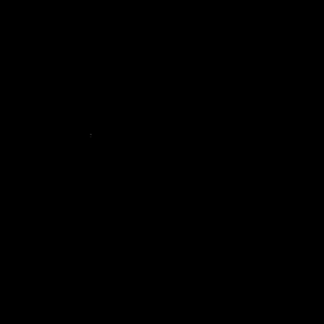
Double slit experiment with single photons !
Particle nature of light/photon !!

Slide 13


Double slit experiment with electron !
Concept of the experiment is same as with bullet
With both the slit open, if the experiment is allowed to continue for a sufficiently long period of time, what is found is that there is an accumulation of flashes in some regions of the screen, and very few, or none, at other parts of the screen. Over a long enough observation time, the accumulation of detections, or flashes, forms an interference pattern, a characteristic of wave motion
δ$=2 π d sinθ/$λ
Probabilities of the electrons striking the screen when one or the other of the two slits are open.

