Slide 1
Special Theory of Relativity
PH101
Lec-5

Slide 2
Geometrical properties of 3D space
Imagine a suitable set of rulers so that the position of a point P can be specified by the three coordinates (x, y, z) with respect to this coordinate system, which we will call R.
We consider two such points P₁ with coordinates (x₁, y₁, z₁) and P₂ with coordinates (x₂, y₂, z₂) then the line joining these two points defines a vector ∆r .
( Length )² in both frame
Angles in both frame
Thus the transformation is consistent with the fact that the length and relative orientation of these vectors is independent of the choice of coordinate systems.

Slide 3
Spacetime four vector
we will consider two events E₁ and E₂ occurring in spacetime. For event E₁ with coordinates (x₁, y₁, z₁, t₁) in frame of reference S and (x₁’, y₁’, z₁’, t₁’) in S’
Lorentz transformations
Separation of two events in spacetime
interval between the two events
Analogous to, but fundamentally different from, the length of a three-vector it can be positive, zero, or negative.
Analogous to the scalar product for three-vectors.
Four-vector

Slide 4
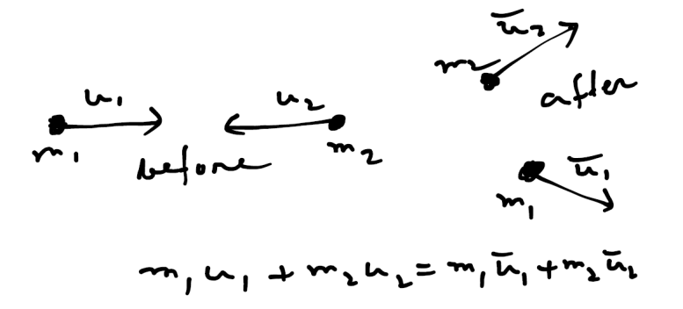
Relativistic Dynamics
Till now we have only been concerned with kinematics !!
we need to look at the laws that determine the motion
The relativistic form of Newton’s Laws of Motion ?
In an isolated system, the momentum p = m u of all the particles involved is constant !
With momentum defined in this way, is momentum conserved in all inertial
frames of reference?
We could study the collision of two bodies !
Collision between two particles of masses m₁ and m₂ !
We will check whether or not this relation holds in all
inertial frame of reference ?
The velocities must be transformed according to the relativistic laws !
Momentum cons.
However, if we retain the Newtonian principle that the mass of a particle is
independent of the frame of reference in which it is measured we find that the above
equation does not hold true in all frames of reference !

Slide 5
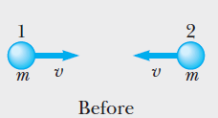
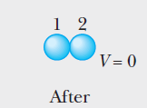

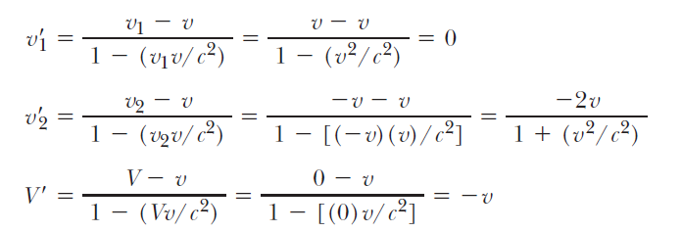
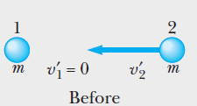
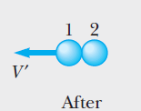

Collision: An Example
Any relativistic generalization of Newtonian momentum must satisfy two criteria:
Relativistic momentum must be conserved in all frames of reference.
2. Relativistic momentum must reduce to Newtonian momentum at low speeds.
Center of mass frame
An inelastic collision between two equal point
Masses, momentum is conserved according to S
Lab frame
The same collision viewed from S’, momentum is not conserved according to S’ !

Slide 6

Relativistic Momentum
Thus the Newtonian definition of momentum and the Newtonian law of conservation of momentum are inconsistent with the Lorentz transformation!!
However , at very low speeds (i.e. v << c) these Newtonian principles are known to
yield results in agreement with observation to an exceedingly high degree of accuracy.
So, instead of abandoning the momentum concept entirely in the relativistic theory, a more reasonable approach is to search for a generalization of the Newtonian concept of momentum in which the law of conservation of momentum is obeyed in all frames of reference.
Using this definition of momentum it can be shown
that momentum is conserved in both S and S’
Relativistic definition of momentum

Slide 7
Relativistic momentum
A more general definition of momentum must be something slightly different from the mass of an object times the object's velocity as measured in a given reference frame, but must be similar to the Newtonian momentum since we must preserve Newtonian momentum at low speeds.
The Lorentz transformation equations for the transverse components of position and velocity are not the same !
Time intervals measured in one reference frame are not equal to time
intervals measured in another frame of reference.
If the momentum is to transform like the position, and not like velocity, we must divide the perpendicular components of the vector position by a quantity that is invariant.
space-time interval
Now, if the displacement of an object measured in a given intertial frame is divided by the space-time interval, we obtain

Slide 8
Velocity four vector
A further four-vector is the velocity four-vector
How the velocity four-vector relates to our usual understanding of velocity ?
Consider a particle in motion relative to the inertial reference frame S => We can identify two events , E₁ at (x,y,z) at time t and E₂ at (x+dx, y+dy, z+dz) at time t+dt !
The displacement in time dt can be represented by four vector ds
proper time interval
The velocity
This is the time interval measured by a clock in its own rest frame as it makes its way between the two events an interval ds apart.
Four velocity associated with the two events E₁ and E₂
If u << c, the three spatial components of the four velocity reduces to the usual components of ordinary three-velocity.

Slide 9
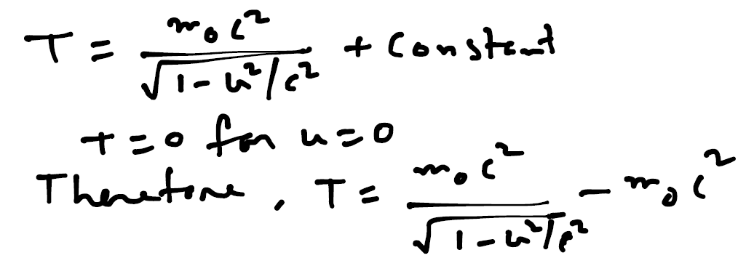
Relativistic kinetic energy
Relativistic Force : F = dp/dt ,
Relativistic Work : dW = F.dr
Relativistic kinetic energy (K.E.)
Hence, the rate of doing work : P = F. u = dT/dt
Integrating with respect to t gives
Classical Newtonian expression for the kinetic energy of a particle of mass moving with a velocity u

Slide 10
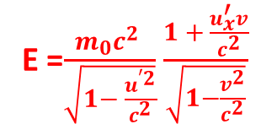
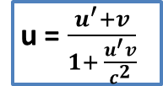
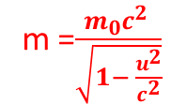




Total Relativistic Energy
We can now define a quantity E by
$\frac{m_{0}c^{2} }{\sqrt{1− \frac{u^{2}}{c^{2}}}}$
= E$=T+ m_{0}c^{2}$
E = m $c^{2}$
m =$\frac{m_{0}c^{2} }{\sqrt{1− \frac{u^{2}}{c^{2}}}}$
u = $\frac{u^{′}+v}{1+ \frac{u^{′}v}{c^{2}}}$
E =$\frac{m_{0}c^{2} }{\sqrt{1− \frac{u^{′2}}{c^{2}}}}$ $\frac{1 + \frac{u_{x}^{′}v}{c^{2}}}{\sqrt{1−\frac{v^{2}}{c^{2}}}}$
Relativistic mass
= $γ ( E^{′}$ +${ p}_{x}^{′} \frac{v}{c^{2}} )$
Thus, if there exists particles of zero rest mass, we see that their energy and momentum are related and that they always travel at the speed of light. Examples are Photon, Neutrinos ?

