Slide 1
Special Theory of Relativity
PH101
Lec-3 & 4

Slide 2

The problem of Simultaneity
Imagine a long platform with an observer located at its midpoint. At either end, at the places marked A and B, there are two momentary flashes of light
Notice that the light signals arrive at the same moment and that they come from places equal distances away !
The two events are simultaneous to the platform observer !
Another outcome !
Imagine that there are clocks located at A and B. If both clocks show the same reading at the events of the two flashes, then according to the platform observer the two clocks are properly synchronized.

Slide 3

Relativity of Simultaneity
Now consider this process from the point of view of an observer who moves relative to the platform along its length.
The midpoint of the platform is in motion.
Nonetheless, the two signals arrive at the midpoint at the same moment.
What is the new observer to make of this?
The light from A must have left earlier than the light from B
The two events are not simultaneous !
The clocks at A and B are not properly synchronized !

Slide 4

Simultaneity and clock synchronization
Two events that are simultaneous in one reference frame (S) are not necessarily simultaneous in another reference frame (S’) moving with respect to the first frame.
An immediate consequence of the constancy of the velocity of light !
Whether or not two events in different places happen at the same time has no
absolute meaning—it depends on the frame of reference in which the events are
described.
A disagreement about whether or not two events are simultaneous immediately implies a disagreement about whether or not two clocks are synchronized (and vice versa).
This suggests that each coordinate system has its own observers with “clocks” that are synchronized…

Slide 5
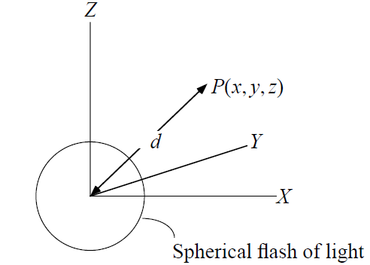
Clock Synchronization
Place observers with clocks throughout a given system !
In that system bring all the clocks together at one place !
Compare the clocks reading !
If all of the clocks agree, then the clocks are said to be synchronized.
Methods to synchronize…
Imagine that at the spatial origin of the frame of
reference we have a master clock, and that at some
instant t₀ = 0 indicated by this clock a spherical
flash of light is emitted from the source.
d² = x² + y² + z²
When this flash reaches P, the clock at that position
is adjusted to read t = d/c !
Therefore, x² + y² + z² = c² t²

Slide 6
Spacetime
Spacetime Events and World Lines
We often represent space and time on a single spacetime diagram, with time on the vertical axis !
An event is something that happens at a given point in space and time, and is represented by a point E(x, t) on a spacetime diagram.
event
$$θ=45°−>Photon, since c=v$$
The path traced out by an object in a spacetime diagram is called its world line !

Slide 7
Lorentz transformation
The special set of linear transformations that:
Preserve the constancy of the speed of light (c) between inertial observers;
Account for the problem of simultaneity between these observers !
We will derive the general form that the transformation law must take purely from
kinematic/symmetry considerations.
Based on two assumptions:
Homogeneity: The intrinsic properties of empty space are the same everywhere and
for all time.
Spatial Isotropy: The intrinsic properties of space is the same in all directions.
No Memory: The extrinsic properties of the rulers and clocks may be functions of
their current states of motion, but not of their states of motion at any
other time.

Slide 8
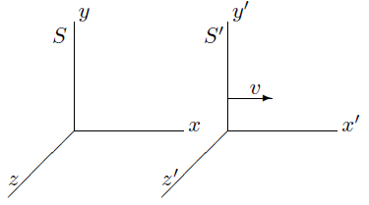


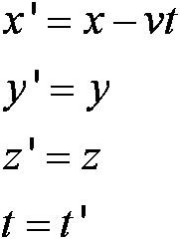

Lorentz transformation
The starting point is to consider two inertial frames S and S’ where S’ is moving with a velocity v relative to S .
Suppose that the origins coincide at t = t’ = 0, and
that at this time there is a burst of light at the origins.
Light travels with speed c in both frames, at time t
in frame S, the wavefront of the light forms a sphere of radius r = ct centered on the
origin of S, and in S’ the wavefront forms a similar sphere of radius r’ =ct’
Spherical wavefronts in S’:
Spherical wavefronts in S
We now try t’ = t + f x
Galilean transformation
Terms will cancel if f= - v/c²
Hence for t’ = t − v x/c²

Slide 9



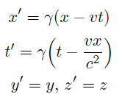
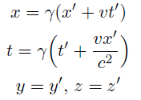
Lorentz transformation
we can remove the (1 – v² /c² ) terms by altering our transformations :
and
,
Also,
Transformation equations represent an intrinsic
property of space and time.
Other material objects, which may have nothing to do with light, will also be
influenced by this fundamental property of space and time.
It is is saying something about the properties of space and time, and the consequent
behaviour that matter and forces must have in order to be consistent with these
properties.

Slide 10
Consequences
The Lorentz transformation leads to a number of important consequences for our understanding of the motion of objects in space and time without concern for how the matter was set into motion, i.e. the kinematics of matter.
We will look at the consequences for our understanding of the laws of
motion themselves, that is relativistic dynamics.
Perhaps the most startling aspect of the Lorentz Transformation is the
appearance of a transformation for time.
Length Contraction : A length gets shortened when measured by observer in
motion with respect to it !
Time Dilation : Clocks slow down when seen by observer moving w.r.t them !
Simultaneity : Two events occurring at the same time !

Slide 11
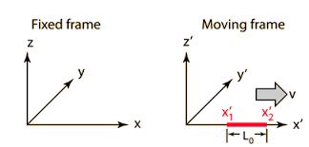


Length contraction
Length no longer has an absolute meaning: the length of an object depends on its motion relative to the frame of reference in which its length is being measured.
Let us consider a rod moving with a velocity v
relative to a frame of reference S , and lying
along the x axis.
As the rod is stationary in S’ , the ends of the rod will have coordinates x’₁ and x’₂
which remain fixed as functions of the time in S’ . The length of the rod, as measured
in S’ is L₀ = x’₂ - x’₁
Proper length of the rod
The length of the rod as measured with respect to S ?
Two measurements made in the fixed frame
and are simultaneously in that frame, t₁ = t₂
L < L₀

Slide 12

Length Contraction
Spaceship moving at v=0.1 c
Spaceship moving at v = 0.85 c
Spaceship moving at v = 0.95 c
Spaceship moving at v = 0.99 c

Slide 13
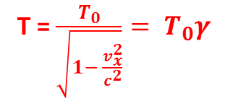
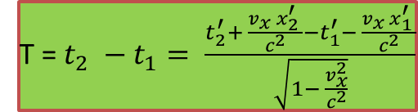
Time dilation
Perhaps the most unexpected consequence of the Lorentz transformation is the way in which our ‘commonsense’ concept of time has to be drastically modified.
Consider a clock C’ placed at rest in a frame of
reference S’ at some point x₁’ on the X axis.
Suppose once again that this frame is moving with a
velocity v_{x} relative to some other frame of reference S .
Some time later, clock C’ will read the time t’₂ at
which instant a different clock C₂ in S will pass the
position x’₁ in S’.
Time interval measured in the moving
frame !
Using Lorenz Transformation
T = $\frac{T_{0}}{\sqrt{1− \frac{v_{x}^{2}}{c^{2}}}}= T_{0}γ$
In the moving frame, time measurements are done in
the same place , x’₂ = x’₁
T = $t_{2} −t_{1}= \frac{t_{2}^{′}+ \frac{v_{x} x_{2}^{′} }{c^{2}}{−t}_{1}^{′}− \frac{v_{x} x_{1}^{′} }{c^{2}}}{\sqrt{1− \frac{v_{x}^{2}}{c^{2}}}}$
Time dilation (T > T₀ )

Slide 14
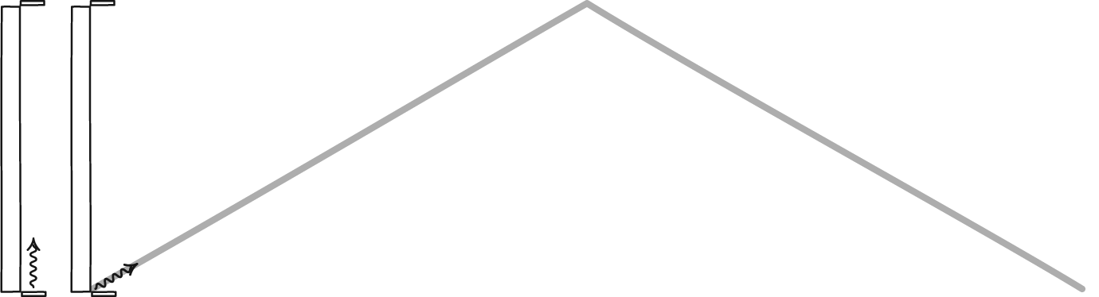
Time dilation
Time dilation due to motion
A light clock at rest and a second light clock that moves perpendicular to its rod. The light signal in the moving clock chases after the rod. To reach the other end, it covers more distance and, as a result, requires more time.
A light signal is reflected back and forth between the mirrors.

Slide 15
Light pulse Clock Method
Time dilation : Consider a light source moving with a velocity v with respect to a frame S’ along the x-axis.

Slide 16


Light pulse clock method
Length contraction
$Total time in S^{′}, τ= ∆t_{1}+ ∆t_{2}= \frac{l}{c−v}$ + $\frac{l}{c+v}= \frac{2lc}{c^{2}−v^{2}}= γ^{2}\frac{2l}{c}$
$Now , τ= γ τ_{0}= γ \frac{2l_{0}}{c}$
Hence, $l= \frac{l_{0}}{γ}$

Slide 17
Simultaneity
Consider two events 1 and 2 which are simultaneous in S i.e. t₁ = t₂, but which occur
at two different places x₁ and x₂
Then, in S’, the time interval between these two events is
t’₂ – t’₁ = γ ( t₂ – v x₂/c² ) - γ ( t₁ – v x₁/c² )
= γ (x₁ –x₂ ) v /c² = 0
Here t’₁ is the time registered on the clock in S’ which coincides with the position x₁
in S at the instant t₁ that the event 1 occurs and similarly for t’₂ .
Note that if the two events occur at the same point (i.e. x₁ = x₂) then the events will
occur simultaneously in all frames of reference.

Slide 18
Implication of cause and effects
Consider two events A and B that occur at coordinate locations x_{A} and x_{B} and at times t_{A} and t_{B}, respectively in the laboratory or Home reference frame !
Reception of that light pulse which triggers the detonation of a bomb
Push of a button which initiates a light pulse
Clearly in the Home Frame, one event causes the other
We demand that all inertial frames "see" the same events occurring in the same order, and not reversed
T = (t_{B} – t_{A} ) > 0 -> time interval in HOME frame !
The time interval in moving frame will follow the same order of events, i.e (t_{B}’ – t_{A}’ ) > 0, only if
The speed of any inertial reference frame which will preserve cause and effect must be less than or equal to the speed of light !

Slide 19
Relativistic Doppler Effect
Consider now an observer in a frame S’ moving along the x-axis with a velocity v away from the source of light (x = x₀ at t = t’=0)
Using Lorentz transformations in S’
Consider a source of light at rest in a frame S at x=0. It emits a crest of light at t=0 and a second crest at time
t=τ = period.
Further simplifications
Change in frequency f-> f’

Slide 20
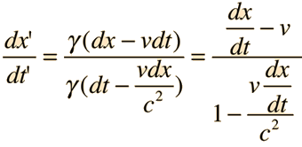



Transformation of Velocities
Suppose, relative to a frame S , a particle has a velocity u = u_{x} i + u_{y} j + u_{z} k
Where u_{x} = dx/dt
What we require is the velocity of this particle as measured in the
frame of reference S’ moving with a velocity v relative to S ?
If the particle has coordinate x at time t in S , then the particle will have coordinate
x’ at time t’ in S’ , such that x’ = γ (x – v t ) and t’= γ ( t – v x/c²)
Let the particle is displaced to a new position x + dx at time t + dt in S , then in S’ it
will be at the position x’ + dx’ at time t’ + dt’
X’ + dx’ = γ ( x + dx – v (t + dt)) and t’ + dt’ = γ ( t + dt – v/c² ( x + dx))
The inverse transformation follows by replacing v -> – v interchanging the primed and unprimed variables

Slide 21



Transformation of Velocities
In particular, if u_{x} = c and u_{y} = u_{z} = 0, we find that
If the particle has the speed c in S , it has the same speed c in S’ !
Now consider the case in which the particle is moving with a speed that is less that c,
i.e. suppose u_{y} = u_{z} = 0 and |u_{x}| < c , therefore
Now, if v < c then along with |u_{x}| < c, it is not difficult to show that the u’_{x} < c !
Therefore, u’_{x} > - c
Therefore, if a particle has a speed less than c in one frame of reference, then its speed is always less than c in any other frame of reference, provided this other frame of reference is moving at a speed less than c !
|u’_{x} |< c

Slide 22
Relativistic Dynamics
Till now we have only been concerned with kinematics !!
we need to look at the laws that determine the motion
The relativistic form of Newton’s Laws of Motion ?
Newton’s Second Law may need revision
Following Newton’s Second Law a particle can be accelerated to a velocity up to and
then beyond the speed of light.
Now if v < c then we find that the factor γ in the Lorentz Transformation
becomes imaginary i.e. the real space and time will transform into imaginary
quantities.
In an isolated system, the momentum p = m u of all the particles involved is constant !
With momentum defined in this way, is momentum conserved in all inertial
frames of reference?
We could study the collision of two bodies !

Slide 23
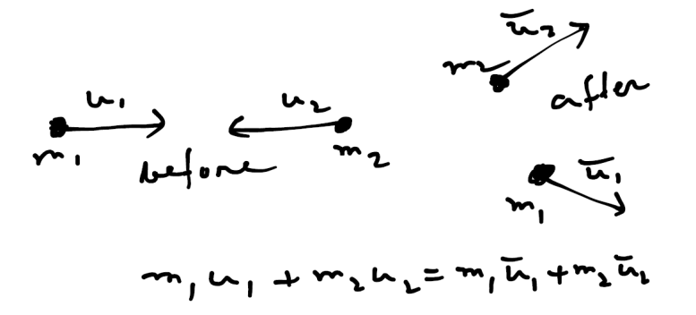
Collision Problem
Collision between two particles of masses m₁ and m₂ !
We will check whether or not this relation holds in all
inertial frame of reference ?
The velocities must be transformed according to the
relativistic laws !
However, if we retain the Newtonian principle that the mass of a particle is
independent of the frame of reference in which it is measured we find that the above
equation does not hold true in all frames of reference !
Thus the Newtonian definition of momentum and the Newtonian law of conservation of momentum are inconsistent with the Lorentz transformation!!
However , at very low speeds (i.e. v << c) these Newtonian principles are known to
yield results in agreement with observation to an exceedingly high degree of accuracy.
So, instead of abandoning the momentum concept entirely in the relativistic theory, a more reasonable approach is to search for a generalization of the Newtonian concept of momentum in which the law of conservation of momentum is obeyed in all frames of reference.

Slide 24
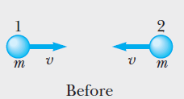
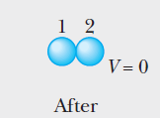

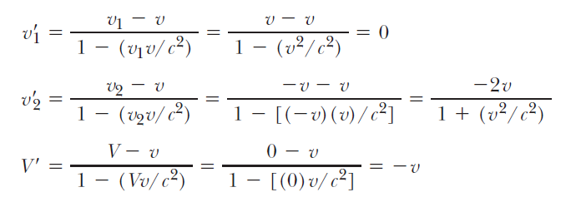
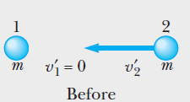
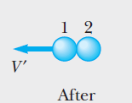


Relativistic Momentum
Any relativistic generalization of Newtonian momentum must satisfy two criteria:
Relativistic momentum must be conserved in all frames of reference.
2. Relativistic momentum must reduce to Newtonian momentum at low speeds.
a
An inelastic collision between two equal point
Masses, momentum is conserved according to S
b
The same collision viewed from S’, momentum
is not conserved according to S’
Using this definition of momentum it can be shown
that momentum is conserved in both S and S’
Relativistic definition of momentum

Slide 25
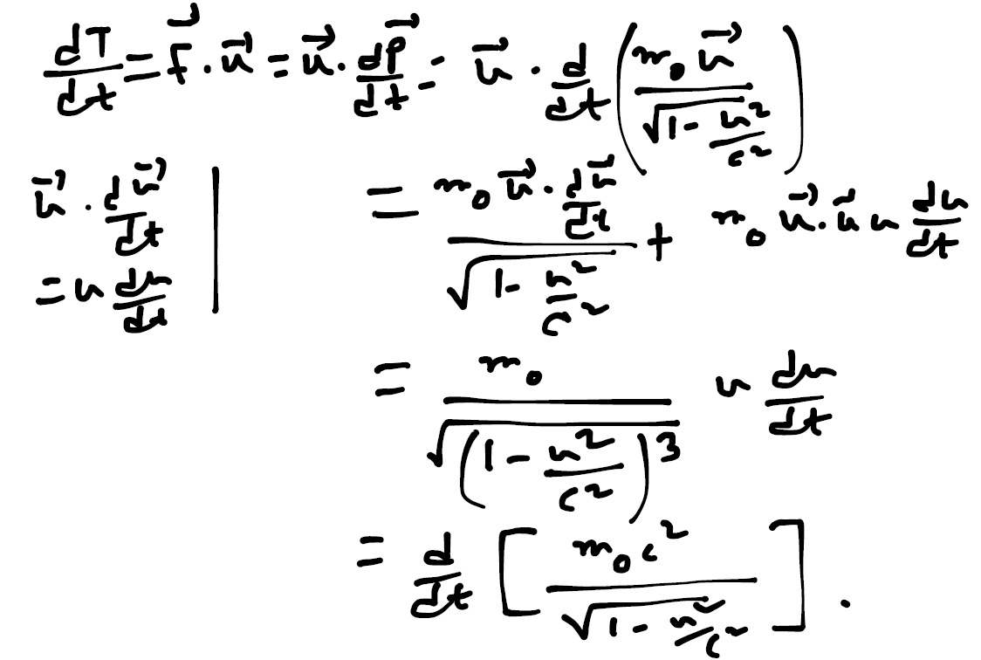
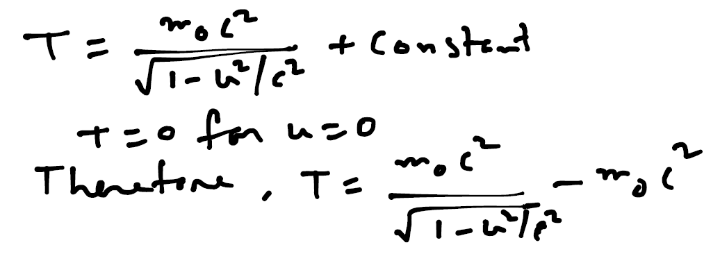
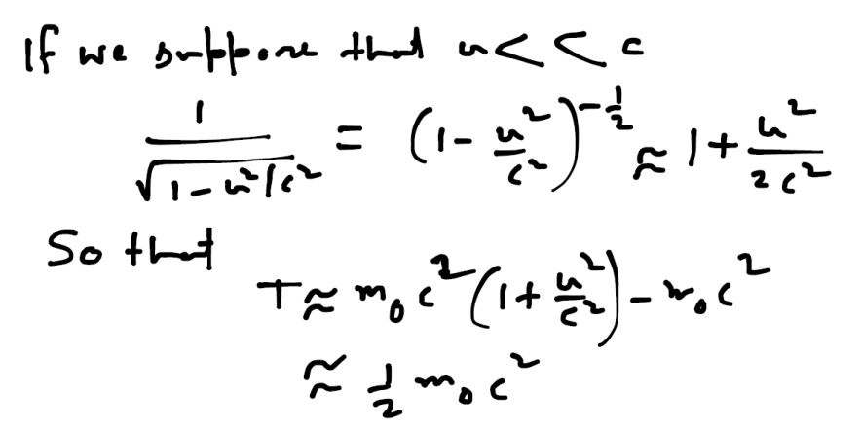
Relativistic kinetic energy
Relativistic Force : F = dp/dt ,
Relativistic Work : dW = F.dr
Relativistic kinetic energy (K.E.)
Hence, the rate of doing work : P = F. u = dT/dt
Integrating with respect to t gives
Classical Newtonian expression for the kinetic energy
of a particle of mass moving with a velocity u

Slide 26
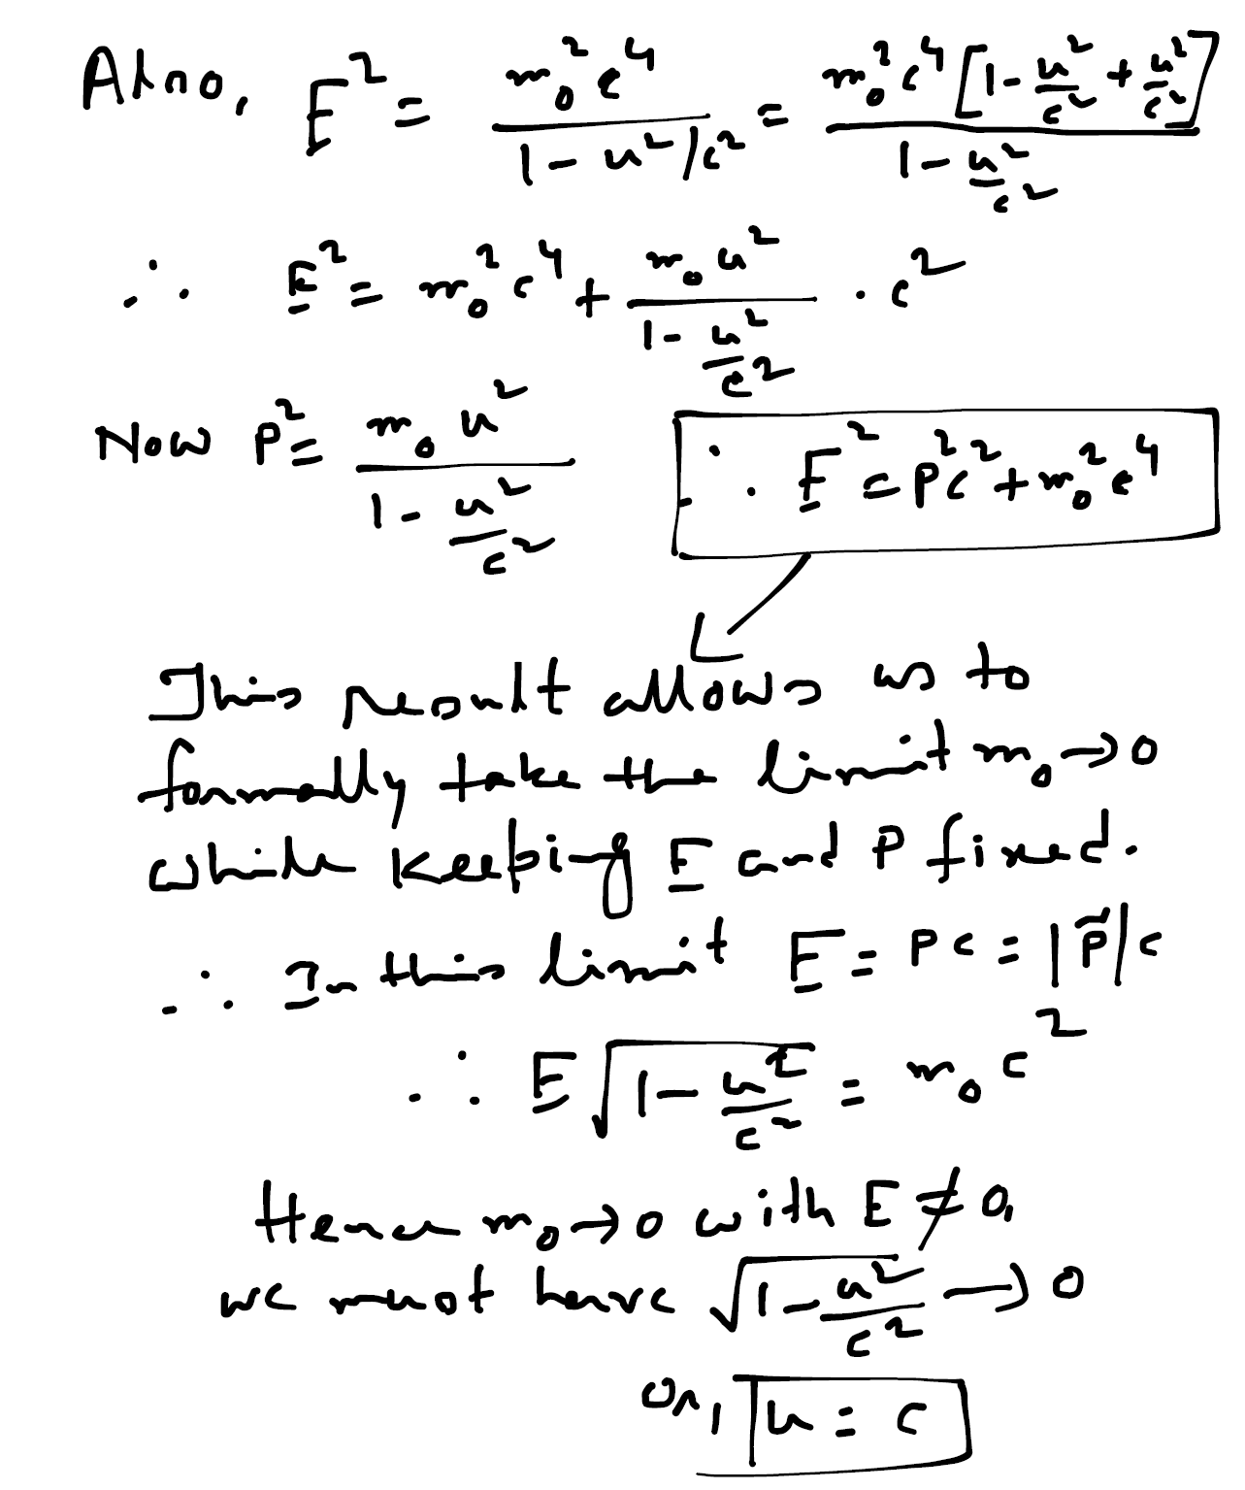
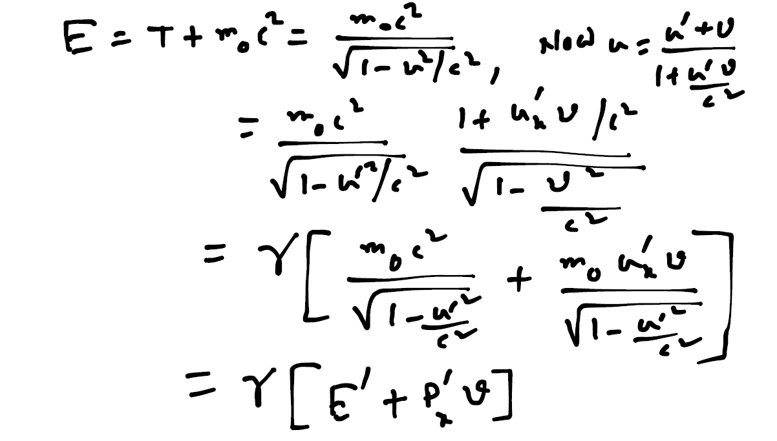
Total Relativistic Energy
We can now define a quantity E by
Thus, if there exists particles of zero rest mass, we see that their energy and momentum are related and that they always travel at the speed of light. Examples are Photon, Neutrinos ?

