Slide 1
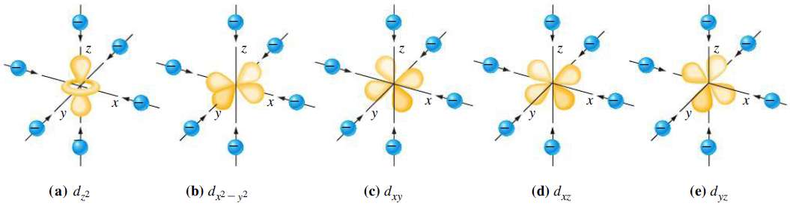
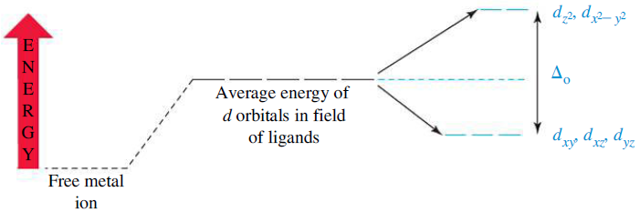
Crystal Field Theory: Octahedral Complexes
Approach of six anions to a metal to form a complex ion with octahedral structure
Splitting of d energy levels in the formation of an octahedral complex ion
metal ion in a spherical
negative field
0.6 Δ_{o}
(e_{g})
0.4 Δ_{o}
(bary center)
(t_{2g})
M^{n+}
(vacuum)

Slide 2
Factors that Affect Crystal Field Splitting
1) Nature of the ligand:
Spectrochemical Series
increasing Δ_{o}
weak field ligands strong field ligands
Ligands with the same donor atoms are close together in the series.
Ligands up to H₂O are weak-field ligands and tend to result in high-spin complexes.
Ligands beyond H₂O are strong-field ligands and tend to result in low-spin complexes.
CFT can not explain why certain anionic ligands lies lower in the series than neutral ligands, although reverse should be expected based on electrostatic interactions.
It also can not explain why OH⁻ lies lower in the series than H₂O and NH₃, although reverse should be expected, since dipole moment of OH⁻ is greater than H₂O and NH₃.

Slide 3
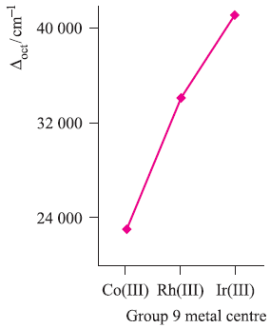
Factors that Affect Crystal Field Splitting
Nature of Ligand
Nature of Metal Ion
Complex | Δ_{o} (cm⁻¹)
[CrCl₆]³⁻ | 13640
[Cr(H₂O)₆]³⁺ | 17830
[Cr(NH₃)₆]³⁺ | 21680
[Cr(CN)₆]³⁻ | 26280
Oxidation State of Metal Ion
Complex | Δ_{o} (cm⁻¹)
[Fe(H₂O)₆]²⁺ | 9400
[Fe(H₂O)₆]³⁺ | 13700
[Co(H₂O)₆]²⁺ | 9300
[Co(H₂O)₆]³⁺ | 18200
Complex | Δ_{o} (cm⁻¹)
[Co(NH₃)₆]³⁺ | 24800
[Rh(NH₃)₆]³⁺ | 34000
[Ir(NH₃)₆]³⁺ | 41000

Slide 4
Factors that Affect Crystal Field Splitting
Mn²⁺< Ni²⁺ < Co²⁺ < Fe²⁺ < V²⁺ < Fe³⁺ < Co³⁺ < Mn⁴⁺ < Mo³⁺ < Rh³⁺ < Ru³⁺ < Pd⁴⁺ < Ir³⁺ < Pt⁴⁺
▪ This trend is independent of ligand.
2) Oxidation State of Metal Ion: Δ_{o} increases with increasing oxidation number of
the metal. This is due to the smaller size of the more highly charged ion, resulting in
smaller metal to ligand distances and hence, a greater ligand field.
3) Nature of Metal Ion: Within any periodic group, Δ_{o} increases down a group
(3d < 4d < 5d). This is due to the larger size of the 4d or 5d orbitals compared with
the compact 3d orbitals and the consequent stronger interactions with the ligands.
▪ For a given ligand and a given oxidation state, Δ_{o} varies irregularly across the first row transition metal elements.
increasing Δ_{o}
Complex | Δ_{o} (cm⁻¹)
[Cr(H₂O)₆]³⁺ | 17400
[Fe(H₂O)₆]³⁺ | 14000
[Co(H₂O)₆]³⁺ | 20760

Slide 5

Crystal Field Stabilization Energy: High & Low Spin Octahedral Complexes
CFSE: Difference in energy between the d electrons in an octahedral crystal field
and the d electrons in a spherical crystal field (isotopic field).
CFSE for (t_{2g})^{x}(e_{g})^{y} configuration = (0.4x - 0.6y)Δ_{o} (ignoring pairing energy)
For d⁴ configuration, the size of the gap (Δ_{o}) will determine whether the fourth electron enters the lower t_{2g} set of orbitals, or the upper e_{g} set of orbitals. The outcome will depend on the relative size of the splitting versus the pairing energy.
Weak Field Case: When the gap is relatively small, the extra electron occupies the upper set of orbitals, rather than pair up with an electron in lower set.
Strong Field Case: When the size of Δ_{o} is substantial, and the gap is too great compared to the pairing energy, the electron pairs up in the lower t_{2g} set.

Slide 6
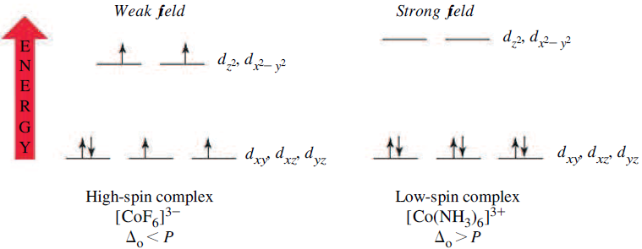
Crystal Field Stabilization Energy: High & Low Spin Octahedral Complexes
CFSE for d⁴ weak field case = [3 × 0.4 Δ_{o} – 1 × 0.6 Δ_{o}] = 0.6 Δ_{o}
CFSE for d⁴ strong field case = 4 × 0.4 Δ_{o} = 1.6 Δ_{o}
The different electron configurations are referred to as high spin (for the weak field case) and low spin (for the strong field case).
The possibility of high and low spin complexes exists for configurations d⁵-d⁷ as well.

Slide 7
Crystal Field Stabilization Energy: High & Low Spin Octahedral Complexes
Electron-pairing energy (P): Energy required to change two electrons with parallel spin in different degenerate orbitals into spin-paired electrons in the same orbital.
Two terms contribute to pairing energy:
a) loss in the exchange energy which occurs upon pairing the electrons.
b) Coulombic repulsion between the spin-paired electrons.
CFSE for (t_{2g})^{x}(e_{g})^{y} configuration = (0.4x - 0.6y)Δ_{o} - pP (considering pairing energy)
p = total number of electron pairs compared to corresponding high-spin configuration; P = mean pairing energy
Free Ion | CFSE
 | High Spin | Low Spin
d⁴ | 0.6Δ_{o} | 1.6Δ_{o} - P
d⁵ | 0Δ_{o} | 2.0Δ_{o} - 2P
d⁶ | 0.4Δ_{o} | 2.4Δ_{o} - 2P
d⁷ | 0.8Δ_{o} | 1.8Δ_{o} - P

Slide 8
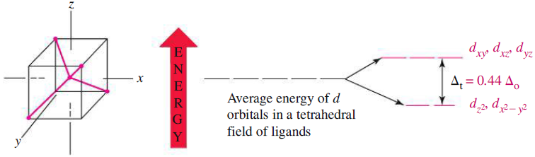
Crystal Field Theory: Tetrahedral Complexes
Δ_{t} = 4/9 Δ_{o} = 0.44 Δ_{o}
(t₂)
(e)
Imagine a tetrahedral molecule inside a cube with metal ions in the center of the cube. The ligands occupy the four alternate corners of the cube leaving the rest four corners empty.
The two ‘e’ (d_{x2-y2} and d_{z2}) orbitals point to the center of the face of the cube while the three ‘t₂’ (d_{xy}, d_{yz} and d_{zx}) orbitals point to the center of the edges of the cube.
Thus, the t₂ orbitals are nearer to the direction of approach of the ligands than the
e orbitals. (The ligands do not directly approach any of the metal d orbitals)

Slide 9
Crystal Field Theory: Tetrahedral Complexes
Why almost all tetrahedral complexes are high spin?
There are only 4 ligands in the tetrahedral complex and hence the ligand field is roughly 2/3 of the octahedral field.
The direction of ligand approach in tetrahedral complex does not coincide with the d-orbitals. This reduces the field by a factor of 2/3. Therefore Δ_{t} is roughly 2/3 x 2/3 = 4/9 of Δ_{o}.
As a result, all tetrahedral complexes are high-spin since the Δ_{t} is normally smaller than the paring energy. Hence, low spin configurations are rarely observed. Usually, if a very strong field ligand is present, square planar geometry will be favored.
When do we expect tetrahedral geometry?
Small metal ions and large ligands (Cl⁻, Br⁻ and I⁻) because then ligand-ligand repulsions cancel the energy advantage of forming more metal-ligand bonds.
Metal ions with zero CFSE (d⁰, d⁵, d¹⁰) or small CFSE (d² and d⁷).
Examples: MnO₄⁻ (d⁰), FeCl₄⁻ (d⁵, h.s.), CoCl₄²⁻ (d⁷, h.s.), ZnCl₄²⁻ (d¹⁰)

