Slide 1
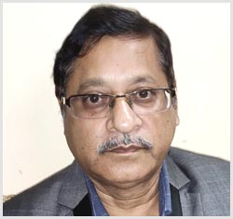
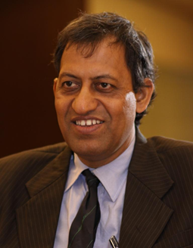
Name | : | Prof Pinakeswar Mahanta
Supervisor | : | Prof S C Mishra
Graduation Year | : | 2001
Current Affiliation | : | Professor of Mechanical Engineering IIT Guwahati Currently on Duputation Director NIT Arunachala Pradesh
Email ID. | : | pinak@iitg.ac.in, director@nitap.ac.in

Slide 2
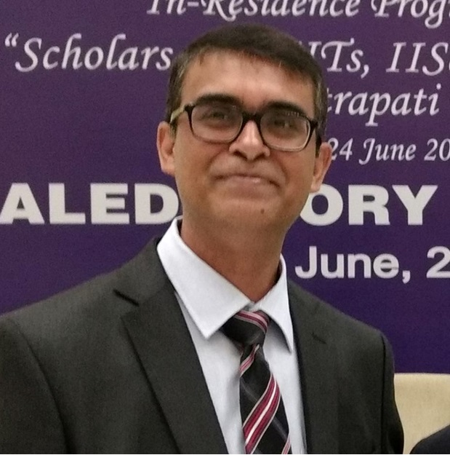
Name | : | Prof Prabal Talukdar
Supervisor | : | Prof S C Mishra
Graduation Year | : | 2004
Current Affiliation | : | Professor of Mechanical Engineering IIT Delhi
Email ID. | : | prabal.talukdar@gmail.com prabal@mech.iitd.ac.in

Slide 3
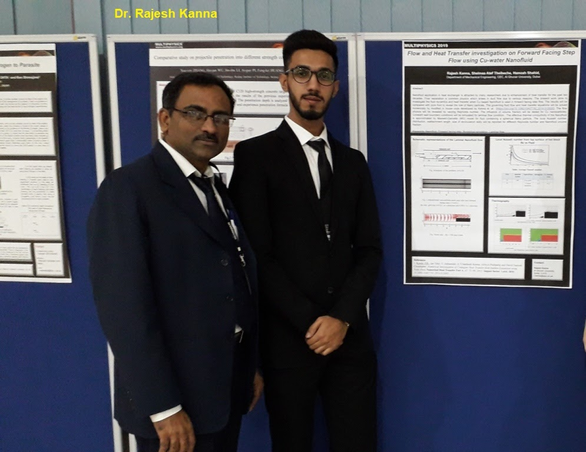
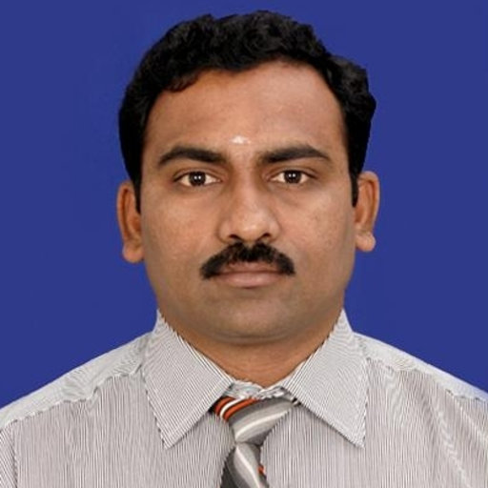
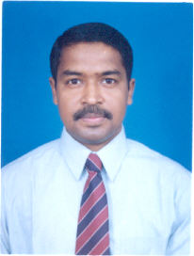
Name | : | Dr. Rajesh Kanna
Supervisor | : | Dr. Manab Kumar Das(now in IITKgp)
Graduation Year | : | 2006
Current Affiliation | : | Asso. Prof and Head, Dept. of Mechanical Engg., Al Ghurair University Dubai, UAE
Email ID. | : | prkanna@gmail.com

Slide 4
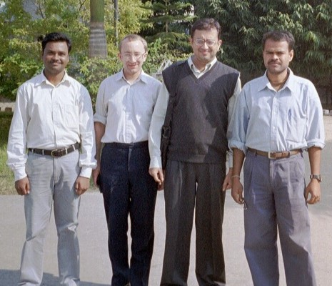
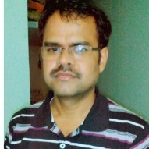
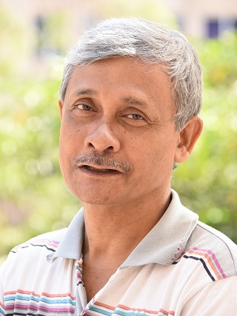
Name | : | Dr. Manabendra Pathak
Supervisor | : | Prof. Anoop Kumar Dass
Graduation Year | : | 2007
Current Affiliation | : | Associate Professor, Department of Mechanical Engineering, Indian Institute of Technology Patna, Bihta, Patna
Email ID. | : | mpathak@iitp.ac.in

Slide 5
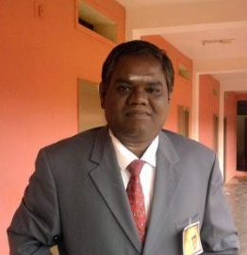
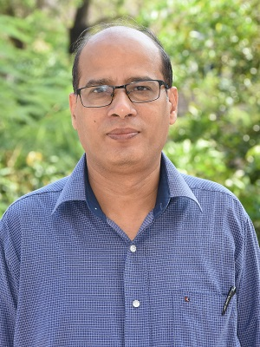
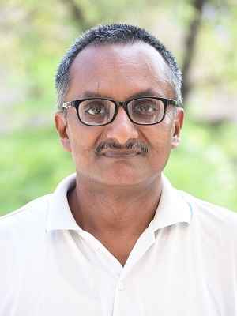
Name | : | Dr. M Sivasankar
Supervisor | : | Prof. S K Dwivedy and Prof Debabrata Chakraborty
Graduation Year | : | 2008
Current Affiliation | :
Email ID. | : | dr.biosankar@gmail.com

Slide 6
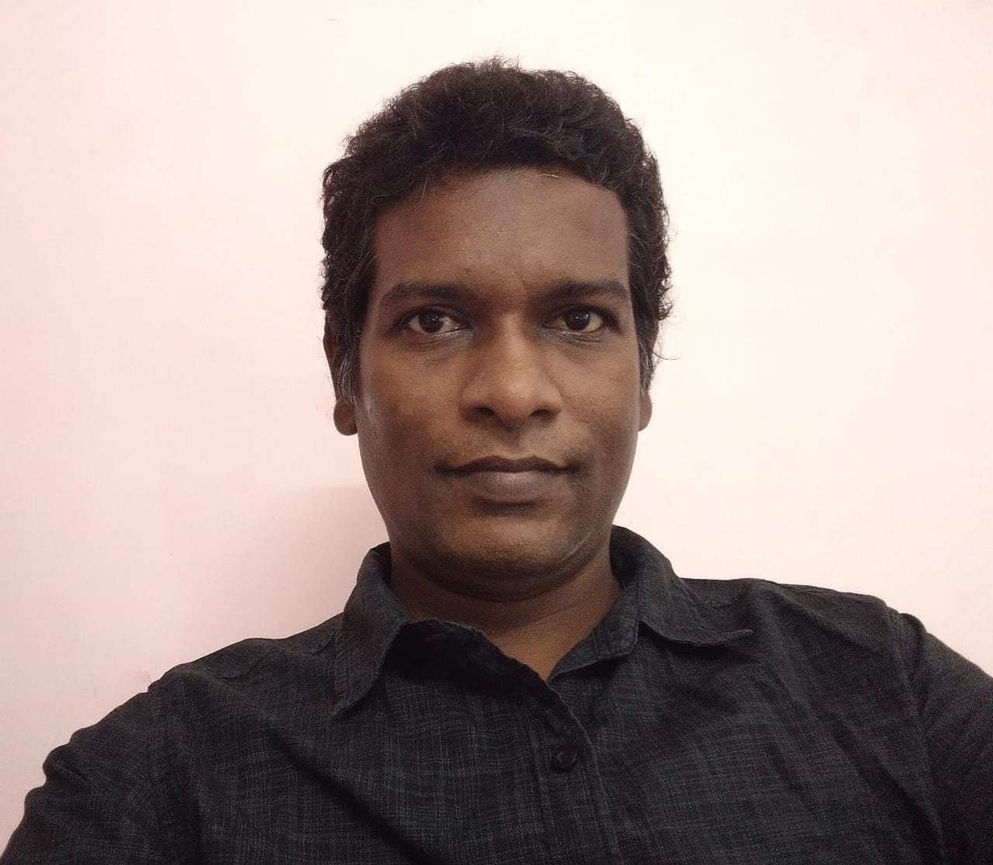
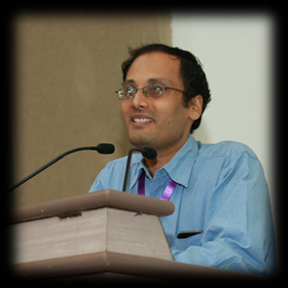
Name | : | Dr. P. Pandithevan;
Supervisor | : | Prof. S. K. Dwivedy and Prof G Saravankumar (Now at IITM)
Graduation Year | : | 2010
Current Affiliation | : | IIITDM Kancheepuram
Email ID. | : | ppthevan@gmail.com

Slide 7
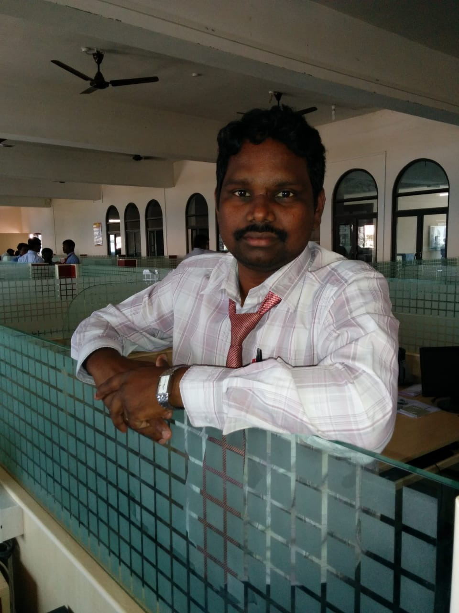
Name | : | Dr. D. Arumuga perumal
Supervisor | : | Prof. Anoop Kumar Dass
Graduation Year | : | 2010
Current Affiliation | : | Assistant Professor, Dept. of Mechanical Engineering, NIT Karnataka, Surathkal
Email ID. | : | perumal@nitk.edu.in

Slide 8
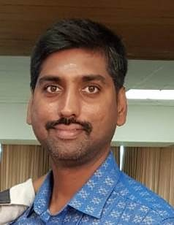
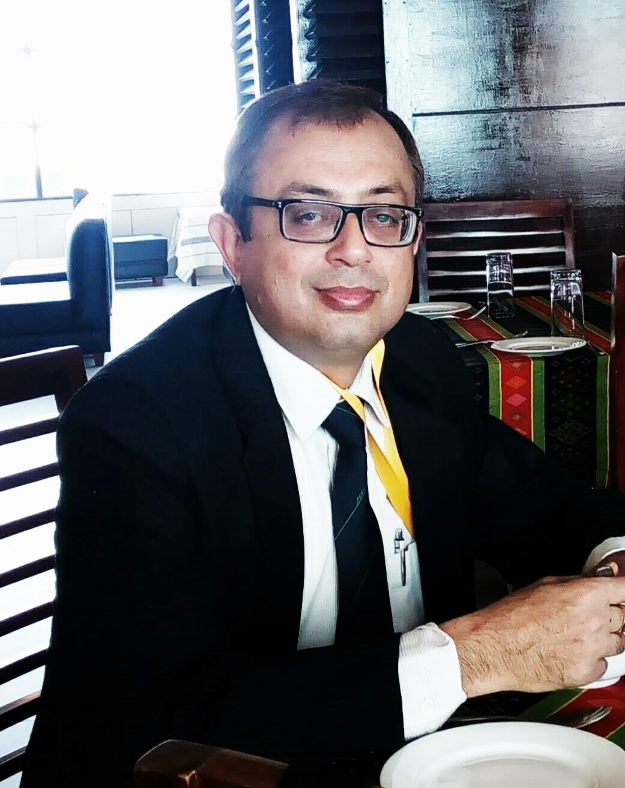
Name | : | Dr. D Santosh Kumar
Supervisor | : | Prof. Anoop Kumar Dass Prof. Anupam Dewan ( Now IIT Delhi)
Graduation Year | : | 2010
Current Affiliation | : | Deputy Manager R & D High pressure Boiler Plant BHEL - Trichy
Email ID. | : | santhoshkumar@bhel.in; dsanthosh2@gmail.com

Slide 9
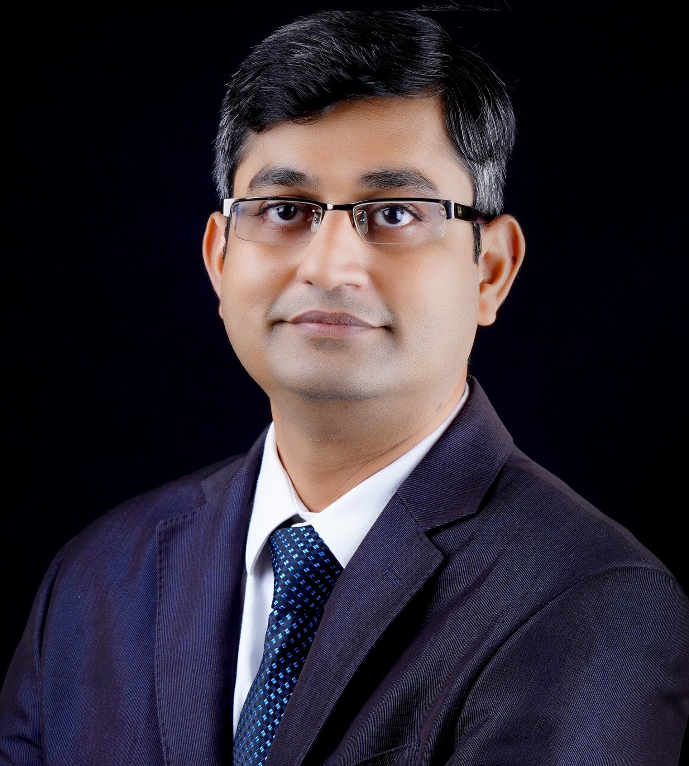
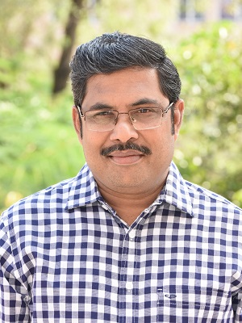
Name: Dr. Vijaya Kumar Pantangi
Supervisor’s Name:
Late Prof. Dr. S. C. Mishra
Prof. Dr. P. Muthukumar
Year of graduation:2010
Email ID: pantangivijay@gmail.com
Current affiliation:
Head of the Department - Product Development
EFD Induction Private LImited, India
Bengaluru
www.efd-induction.com

Slide 10
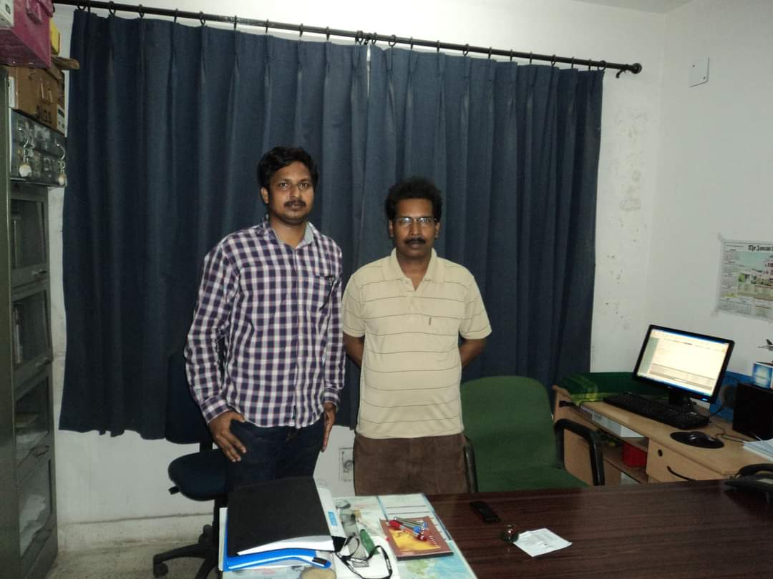
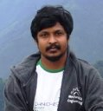
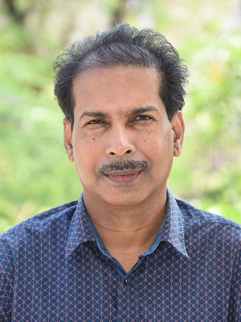
Name | : | Dr. M Eswaran
Supervisor | : | Prof. Ujjwal K Saha
Graduation Year | : | 2011
Current Affiliation | : | Scientist in IGCAR, Kalpakkam
Email ID. | : | eswarm21@gmail.com

Slide 11
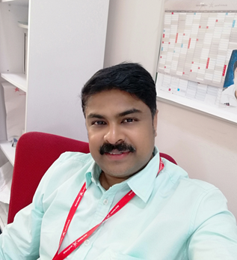
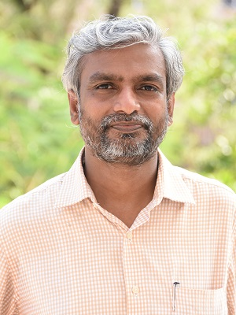
Name | : | Dr. C. Subramanian
Supervisor | : | Prof. S. Senthilvelan
Graduation Year | : | 2011
Current Affiliation | : | Assistant Professor, Department of Mechanical Engineering, BAHRAIN TECHNICAL COLLEGE UNIVERSITY OF BAHRAIN PO Box 33349, Isa Town, Kingdom of Bahrain
Email ID. | : | janisubu@gmail.com

Slide 12
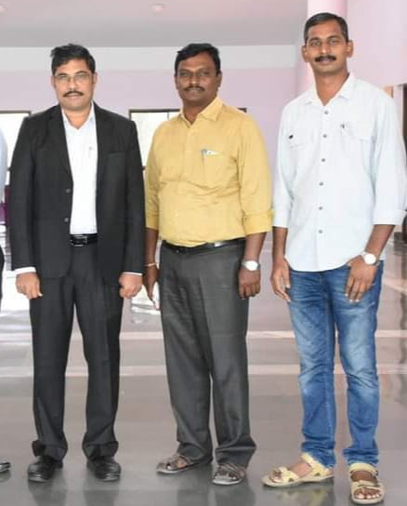
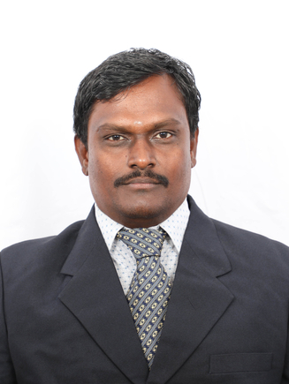
Name | : | Dr A. Satheesh
Supervisor | : | Prof. P. Muthukumar & Prof. Anupam Dewan (IIT Delhi)
Graduation Year | : | 2011
Current Affiliation | : | Professor, Department of Thermal and Energy Engineering, School of Mechanical Engineering, VIT-Vellore, Tamilnadu
Email ID. | : | egsatheesh@gmail.com

Slide 13
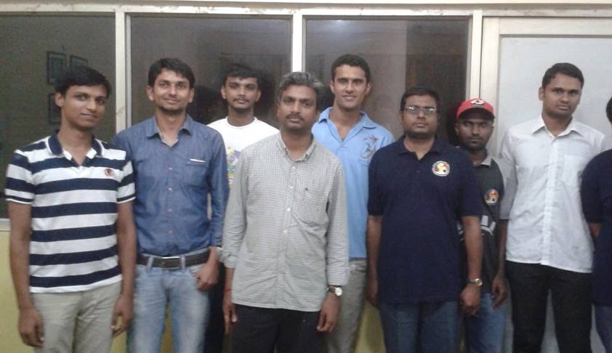
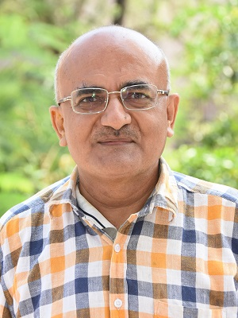
Name | : | Dr. R Kalidasan
Supervisor | : | Prof. S Senthilvelan & Prof. U S Dixit
Graduation Year | : | 2012
Current Affiliation | : | Associate Professor School of Mechanical Engineering, Lovely Professional University, Punjab
Email ID. | : | rkalidasan2002@yahoo.com

Slide 14
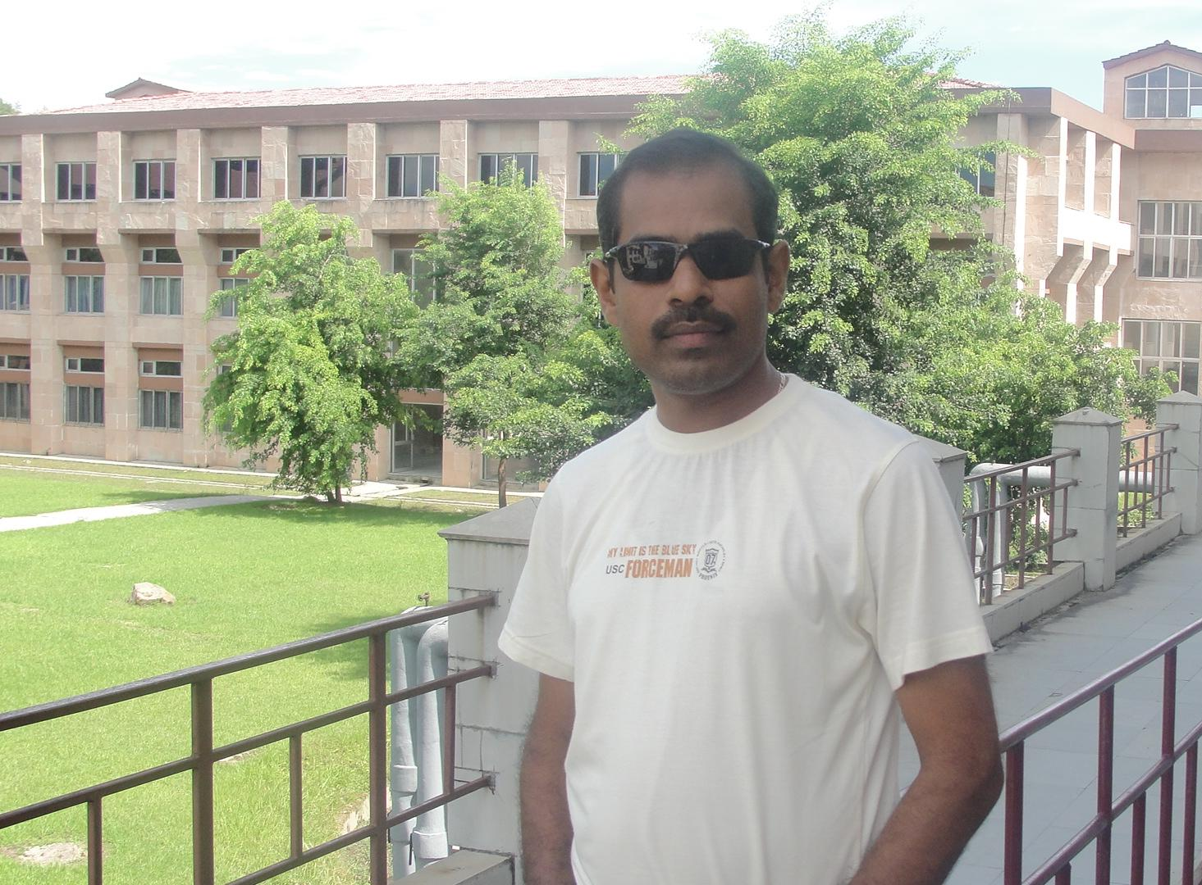
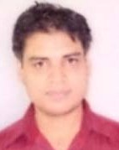
Name | : | Dr. Dillip Kumar Biswal
Supervisor | : | Dr. Dibakar Bandopadhya and Prof. S.k.Dwivedy
Graduation Year | : | 2012
Current Affiliation | : | Associate Professor and Head Department of Mechanical Engineering, C V Raman Global University, Bhubaneswar, odisha
Email ID. | : | dillipkumarbiswal@gmail.com

Slide 15
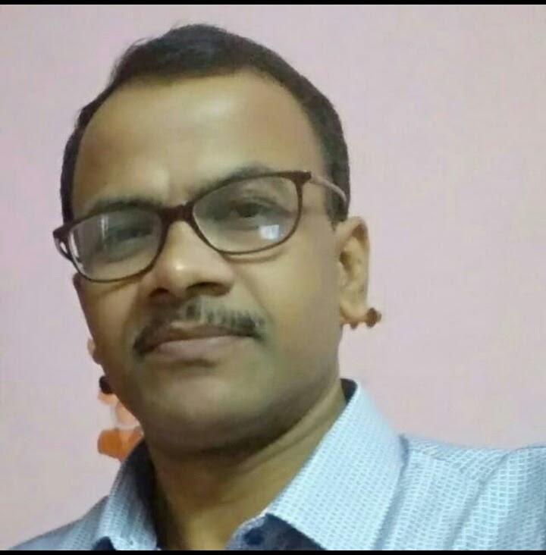
Name | : | RATNAKAR DAS
Supervisor | : | Professor U. S. Dixit
Graduation Year | : | 2012
Current Affiliation | : | Assistant Professor, Department of Manufacturing Engineering, National Institute of Foundry and Forge Technology Hatia, Ranchi, Jharkhand
Email ID. | : | ratnakar.nifft@gov.in & ratankd@gmail.com

Slide 16
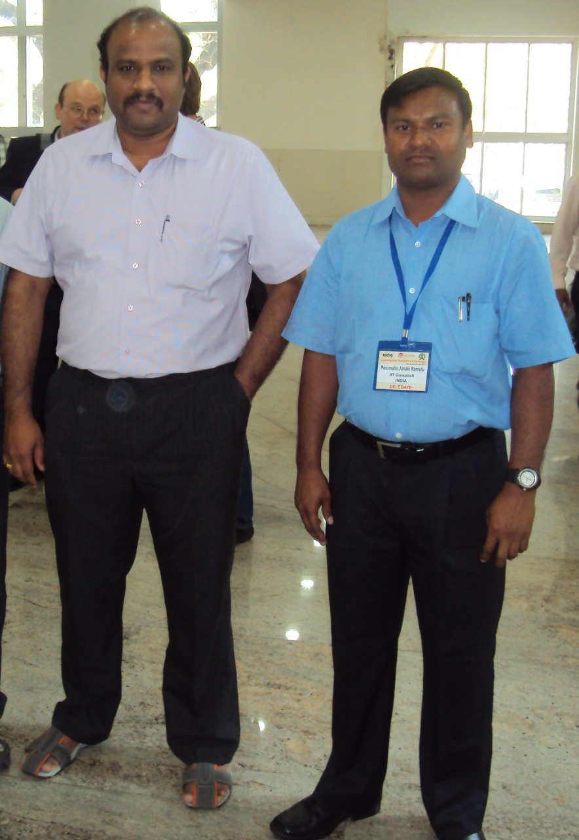
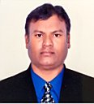
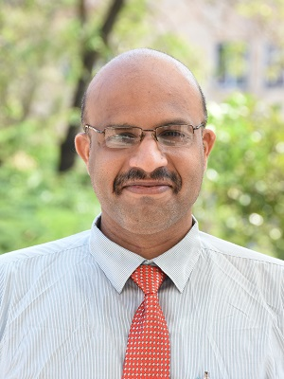
Name | : | Dr. PERUMALLA JANAKI RAMULU
Supervisor | : | Prof. R. Ganesh Narayanan
Graduation Year | : | 2013
Current Affiliation | : | Associate Professor & Director for CoE-Advance Manufacturing Engineering School of Mechanical, Chemical and Materials Engineering, Adama Science and Technology University, Adama, Ethiopia.
Email ID. | : | srirama309@gmail.com; perumalla.janaki@astu.edu.et

Slide 17
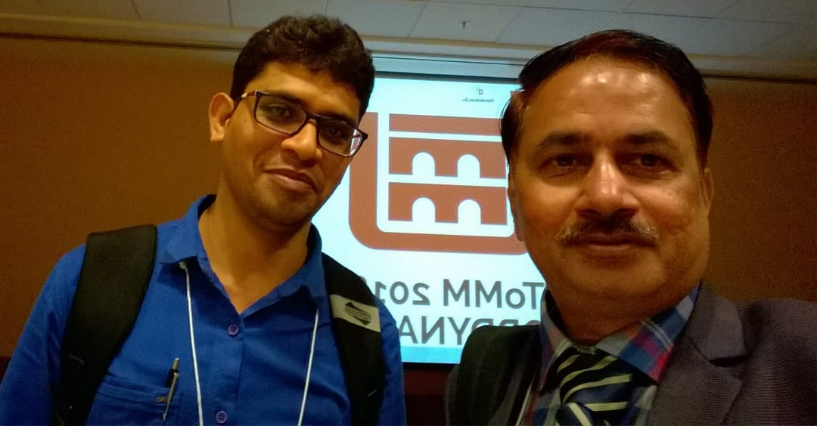
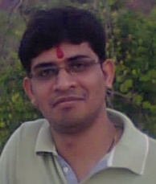
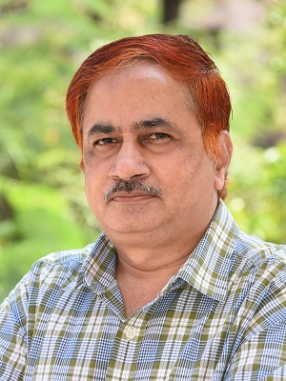
Name | : | Dr. Mohit Lal
Supervisor | : | Prof. Rajiv Tiwari
Graduation Year | : | 2013
Current Affiliation | : | Assistant Professor Industrial Design department, NIT Rourkela
Email ID. | : | dr.mohitlal@gmail.com

Slide 18
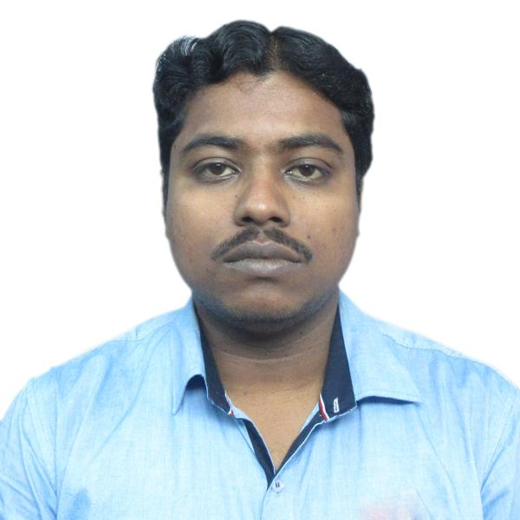
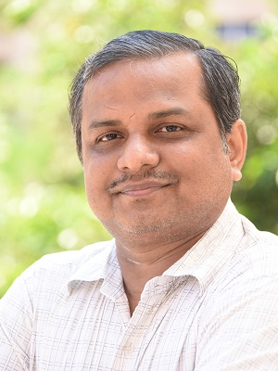
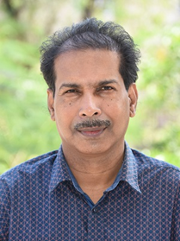
Name | : | Dr. Biplab K Debnath
Supervisor | : | Prof. U.K. Saha Prof. N. Sahoo
Graduation Year | : | 2013
Current Affiliation | : | Assistant Professor, Department of Mechanical Engineering, NIT Meghalaya, Shillong
Email ID. | : | biplab.debnath@nitm.ac.in

Slide 19
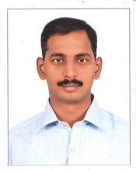
Name | : | Dr. Anbarasu Subramanian
Supervisor | : | Prof. P. Muthukumar & Late Prof. Subhash C. Mishra
Graduation Year | : | 2014
Current Affiliation | : | Assistant Professor, Dept. of Mechanical Engineering, NIT Rourkela, Odisha
Email ID. | : | anbarasus@nitrkl.ac.in (O) s.barasu@gmail.com (P)

Slide 20
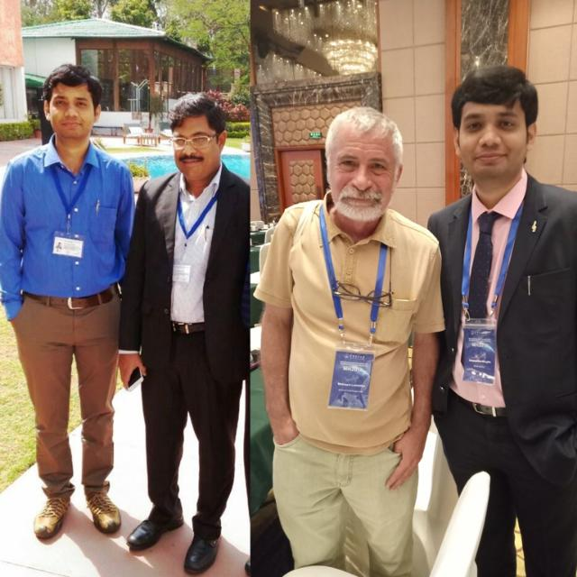
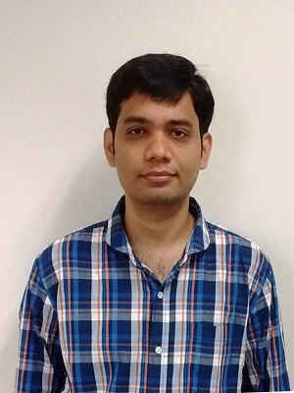
Name | : | Bhogilla Satya Sekhar
Supervisor | : | Prof. P. Muthukumar
Graduation Year | : | 2014
Current Affiliation | : | Assistant Professor, Mechanical Engineering Department, IIT Jammu
Email ID. | : | satyasekhar6@gmail.com

Slide 21
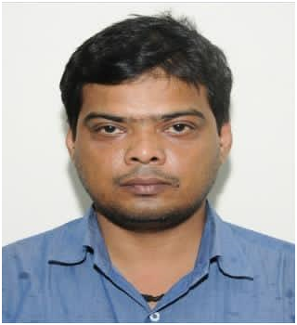
Name | : | Dr. Rakesh Kumar
Supervisor | : | Prof. Niranjan Sahoo
Graduation Year | : | 2014
Current Affiliation | : | Assistant Professor, Department of Mechanical Engineering, IIT(ISM) Dhanbad, Dhanbad - 826004, Jharkhand
Email ID. | : | rakesh@iitism.ac.in, rakeshkism@gmail.com

Slide 22
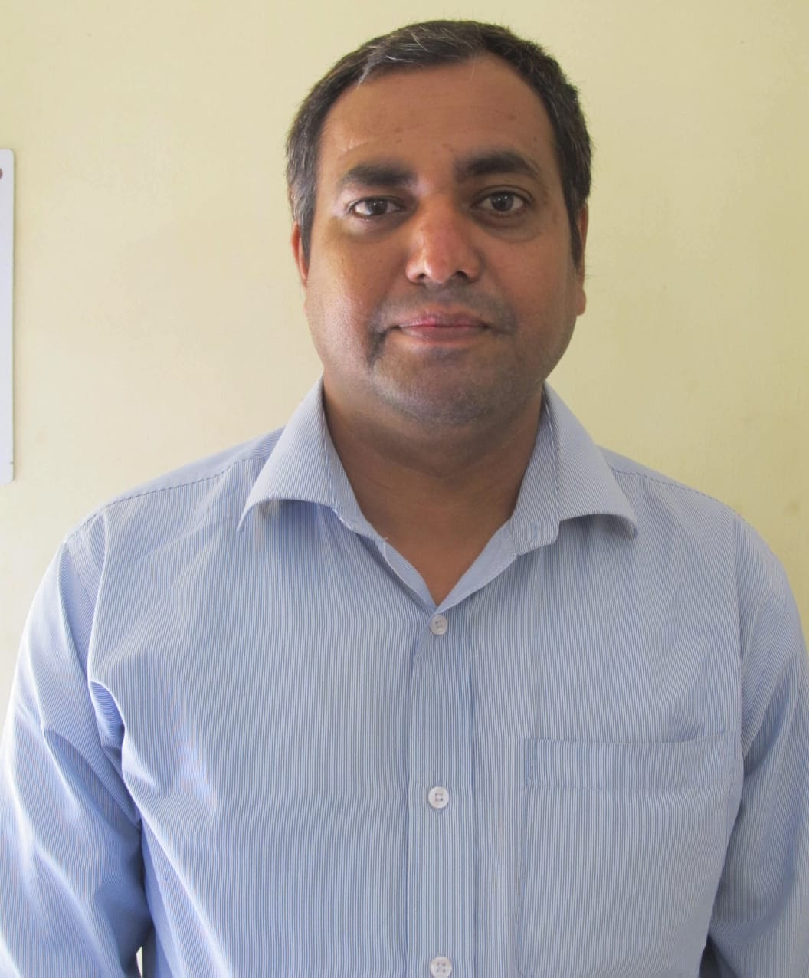
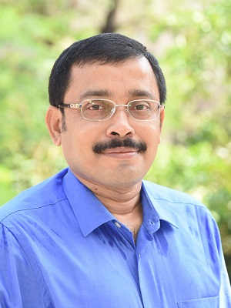
Name | : | Pitambar Randive
Supervisor | : | Prof. Amaresh Dalal
Graduation Year | : | 2014
Current Affiliation | : | Assistant Professor, NIT Silchar - Assam
Email ID. | : | pitambar@mech.nit.ac.in

Slide 23
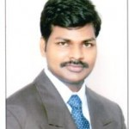
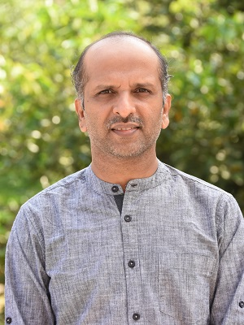
Name | : | Dr. Ravi K. Peetala
Supervisor | : | Prof. Vinayak kulkarni and Prof. Niranjan shoo.
Graduation Year | : | 2014
Current Affiliation | : | Assistant professor, Visvesvaraya National Institute of Technology Nagpur
Email ID. | : | ravipeetala@gmail.com rkpeetala@mec.vnit.ac.in

Slide 24
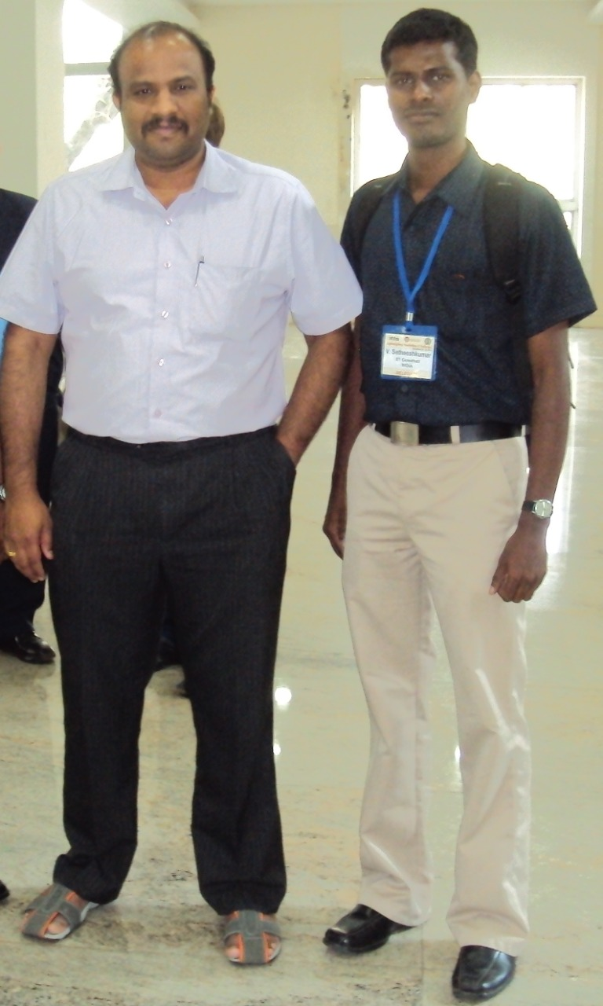
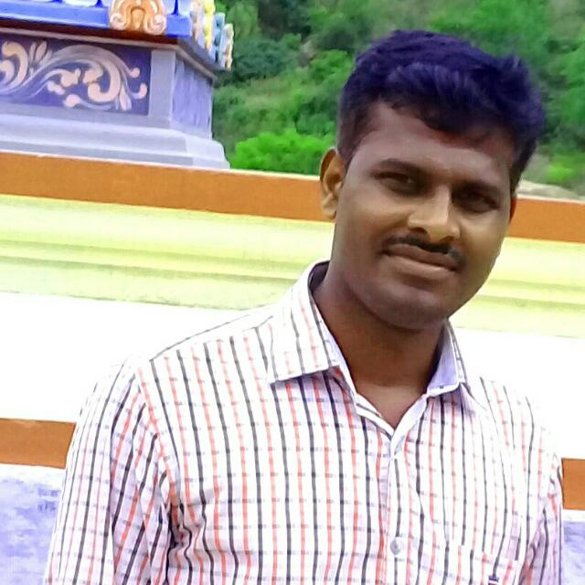
Name | : | Dr. SATHEESHKUMAR V
Supervisor | : | Prof. R. Ganesh Narayanan
Graduation Year | : | 2015
Current Affiliation | : | Assistant Professor, Department of Mechanical Engineering, National Institute of Technology Tiruchirappalli Tiruchirappalli, Tamil Nadu - 620 015, INDIA
Email ID. | : | satheeshv@nitt.edu

Slide 25
Name | : | Dr. Biswajit Parida
Supervisor | : | Prof. Sukhomay Pal
Graduation Year | : | 2015
Current Affiliation | : | Lecturer & HOD (I/C), Department of Mechanical Engineering, Skill Development & Technical Education Department, Govt. of Odisha. Odisha
Email ID. | : | bisu.katak@gmail.com

Slide 26
Name | : | Dr. Sukanta Roy
Supervisor | : | Prof. Ujjwal K. Saha
Graduation Year | : | 2015
Current Affiliation | : | Head of Department & Senior Lecturer, Department of Mechanical Engineering, Curtin University, Malaysia Campus
Email ID. | : | sukantamech07@gmail.com sukanta.roy@curtin.edu.my

Slide 27
Name | : | Dr. C. Shravankumar
Supervisor | : | Prof. Rajiv Tiwari
Graduation Year | : | 2015
Current Affiliation | : | Assistant Professor Department of Mechanical Engineering, SRM Institute of Science and Technology, Tamilnadu, India
Email ID. | : | shavanc@srmist.edu.in

Slide 28
Name | : | Dr. Manjula Das Ghatak
Supervisor | : | Prof. P. Mahanta
Graduation Year | : | 2015
Current Affiliation | : | Assistant professor, Department of Mechanical, NIT Arunachal Pradesh
Email ID. | : | manjula@nitap.ac.in

Slide 29
Name | : | Dr. Jaagannath Sardar
Supervisor | : | Dr. Dibakar Bandopadhya
Graduation Year | : | 2015
Current Affiliation | : | Scientist - C at Central Silk Board, posting at Varanasi
Email ID. | : | jagannath81iitd@gmail.com jagannath.csb@gov.in

Slide 30
Name | : | Dr. Sathisha H M.
Supervisor | : | Prof.Amaresh Dalal
Graduation Year | : | 2015
Current Affiliation | : | Assistant Professor, The National Institute of Engineering, Mysore, Karnataka.
Email ID. | : | sathishahm67@gmail.com

Slide 31
Name | : | Dr. Ramesh Babu Pallekonda
Supervisor | : | Prof. Vinayak Kulkarni & Prof.S.K.Dwivedy
Graduation Year | : | 2015
Current Affiliation | : | Assistant Professor, Department of Mechanical Engineering, NIT Meghalaya, Shillong
Email ID. | : | pallekonda@nitm.ac.in

Slide 32
Name | : | Dr. Yadaiah Nirsanametla
Supervisor | : | Prof. Swarup Bag
Graduation Year | : | 2015
Current Affiliation | : | Assistant Professor, Department of Mechanical Engineering, North Eastern Regional Institute of Science and Technology, Nirjuli, Arunachal Pradesh 791109
Email ID. | : | ny@nerist.ac.in yaadudme@gmail.com

Slide 33
Name | : | Anil Kumar Deepati
Supervisor | : | Prof. Pankaj Biswas
Graduation Year | : | 2015
Current Affiliation | : | Assistant Professor, Jazan University, Saudi Arabia
Email ID. | : | adeepati@jazanu.edu.sa

Slide 34
Name | : | Dr G.Thrisekhar reddy
Supervisor | : | Prof.Sashindra kumar kakoty
Graduation Year | : | 2015
Current Affiliation | : | Associate Professor, Department of Mechanical Engineering, MALLA REDDY COLLEGE OF ENGINEERING AND TECHNOLOGY Hyderabad, Telangana.
Email ID. | : | sekhar02351@gmail.com

Slide 35
Name | : | Dr. Amitava Ghatak
Supervisor | : | Prof. P.S. Robi
Graduation Year | : | 2015
Current Affiliation | : | Assistant professor, Department of Mechanical, Techno India University, Kolkata
Email ID. | : | amitavaghatak7@gmail.com

Slide 36
Name | : | Dr. H. Lalhmingsanga
Supervisor | : | Prof. Pinakeswar Mahanta
Graduation Year | : | 2015
Current Affiliation | : | Asst. Professor NIT Mizoram
Email ID. | : | hlalhmingsang@gmail.com

Slide 37
Name | : | Dr. N. Shanmuga priya
Supervisor | : | Prof. S. Kanagaraj
Graduation Year | : | 2016
Current Affiliation | : | Assistant professor, Department of Mechanical, Siddaganga Institute of Technology, Tumkuru, Karnataka
Email ID. | : | shanmugapriyansp@gmail.com /nspriya@sit.ac.in

Slide 38
Name | : | Dr. Seikh Mustafa Kamal
Supervisor | : | Prof. Uday S Dixit
Graduation Year | : | 2016
Current Affiliation | : | Assistant Professor, Department of Mechanical Engineering, IIT Jammu.
Email ID. | : | seikh.kamal@iitjammu.ac. in

Slide 39
Name | : | Dr. S. Arun
Supervisor | : | Prof. S. Kanagaraj
Graduation Year | : | 2016
Current Affiliation | : | Scientist, CSIR National Aerospace Laboratories Bangalore.
Email ID. | : | aruns@nal.res.in

Slide 40
Name | : | Dr. T. Moasunep Jamir
Supervisor | : | Prof. S. K. Kakoty Prof. Karuna Kalita.
Graduation Year | : | 2016
Current Affiliation | : | Assistant Professor Debre Berhan Univeristy, Debre Berhan, Ethiopia
Email ID. | : | sunepbokdi@gmail.com

Slide 41
Name | : | Dr. Ravi Kant
Supervisor | : | Prof. Shrikrishna N. Joshi
Graduation Year | : | 2016
Current Affiliation | : | Assistant Professor, Department of Mechanical Engineering, IIT Ropar
Email ID. | : | only4ravikant@gmail.com ravi.kant@iitrpr.ac.in

Slide 42
Name | : | A. Muthuraja
Supervisor | : | Prof. S. Senthilvelan
Graduation Year | : | 2016
Current Affiliation | : | Associate Professor, Department of Mechanical Engineering, PRIST University, Vallam, Thanjavur, Tamilnadu
Email ID. | : | a.muthuraja2010@gmail.com

Slide 43
Name | : | Debaleena Chakraborty
Supervisor | : | Dr. Debabrata Chakraborty & Dr. K. S. R. K. Murthy
Graduation Year | : | 2016
Current Affiliation | : | Lead Engineer with GE Aviation, Bangalore
Email ID. | : | chakra.debaleena@gmail.com

Slide 44
Name | : | A. Johnney Mertens
Supervisor | : | Prof. S. Senthilvelan
Graduation Year | : | 2016
Current Affiliation | : | Associate Professor, Department of Mechanical Engineering, National Institute of Technology - Puducherry, Karaikal.
Email ID. | : | johnneymertens@gmail.com & johnney.m@nitpy.ac.in

Slide 45
Name | : | Dr. Azd Zayoud
Supervisor | : | Prof. Dr. U. K. Saha & Prof. Dr. P. Mahanta
Graduation Year | : | 2017
Current Affiliation | : | Post Doctoral Fellow, Laboratory for Chemical Technology (LCT), Ghent, East Flanders, Belgium, Germany.
Email ID. | : | zayoud@gmail.com

Slide 46
Name | : | Dr. Hakeem Niyas U S
Supervisor | : | Prof. P. Muthukumar
Graduation Year | : | 2017
Current Affiliation | : | Assistant professor, Energy Institute, Bengaluru (Centre of Rajiv Gandhi Institute of Petroleum Technology, Jais) Rajaji Nagar, Bengaluru, Karnataka, 560010
Email ID. | : | hakeemnus@rgipt.ac.in hakeemniyas@gmail.com

Slide 47
Name | : | Dr. Jai Manik
Supervisor | : | Prof. Amaresh Dalal
Graduation Year | : | 2017
Current Affiliation | : | Computational Fluids Scientist, ExxonMobil services and technology Pvt Ltd, Bangalore,
Email ID. | : | jaimanik1985@gmail.com

Slide 48
Name | : | Dr Gyan Sagar Sinha
Supervisor | : | Prof P Muthukumar & Prof. S C Mishra
Graduation Year | : | 2017
Current Affiliation | : | Assistant Professor II, KIIT Deemed University, Bhubaneswar.
Email ID. | : | gyansagar49@gmail.com

Slide 49
Name | : | Dr. Gururaj Bolar
Supervisor | : | Dr. S.N. Joshi
Graduation Year | : | 2017
Current Affiliation | : | Assistant Professor, Manipal Academy of Higher Education, Manipal.
Email ID. | : | gururaj.bolar@gmail.com, gururaj.bolar@manipal.edu

Slide 50
Name | : | Dr. Mayuri Baruah
Supervisor | : | Dr. Swarup Bag
Graduation Year | : | 2017
Current Affiliation | : | Assistant professor, Production and industrial engineering department, NIT Jamshedpur
Email ID. | :

Slide 51
Name | : | Dr Shrutidhara Sarma
Supervisor | : | Prof Niranjan Sahoo
Graduation Year | : | 2017
Current Affiliation | : | Assistant Professor IIT Jodhpur
Email ID. | : | shrutidhara@iitj.ac.in

Slide 52
Name | : | Dr. Paragmoni Kalita
Supervisor | : | Prof. Anoop Kumar Dass
Graduation Year | : | 2017
Current Affiliation | : | Assistant Professor, Current Affiliation: Department of Mechanical Engineering, Tezpur University Assam, India-784028
Email ID. | : | paragmoni@gmail.com

Slide 53
Name | : | Dr. Gajanan Namdeorao Shelke
Supervisor | : | Prof. Pinakeswar Mahanta
Graduation Year | : | 2017
Current Affiliation | : | Professor and Dean R&D, Sandip Institute of Engineering and Management Nashik (MS)
Email ID. | : | gnshelke@gmail.com

Slide 54
Name | : | Dr. Purushottam Gangsar
Supervisor | : | Prof Rajiv Tiwari
Graduation Year | : | 2018
Current Affiliation | : | Assistant Professor, Dept. of Mechanical Engineering, Shri G S Institute of Technology and Science, Indore, MP
Email ID. | : | purushottam.gangsar@gmail.com

Slide 55
Name | : | Dr. Sachin Singh
Supervisor | : | Dr. M. Ravi Sankar
Graduation Year | : | 2018
Current Affiliation | : | Assistant Professor, Thapar Institute of Engineering and Technology, Patiala
Email ID. | :

Slide 56
Name | : | Dr. Sumit Agarwal
Supervisor | : | Prof. Dr. Niranjan Sahoo
Graduation Year | : | 2018
Current Affiliation | : | Post Doctoral Fellow, Physikalisch-Technische Bundesanstalt (PTB), Braunschweig, Germany
Email ID. | : | sumitmechiitg@gmail.com
Dr. Sumit Agarwal

Slide 57
Name | : | Dr. Vinod Pandey
Supervisor | : | Prof. Gautam Biswas Prof. Amaresh Dalal
Graduation Year | : | 2018
Current Affiliation | : | Post doctoral researcher CEA Saclay, France.
Email ID. | : | pandeyvinod4@gmail.com

Slide 58
Name | : | Dr. Preetirekha Borgohain
Supervisor | : | Prof. Amaresh Dalal
Graduation Year | : | 2018
Current Affiliation | : | Lead Analyst Numerical Computations and Scientific Programming. CGI, Bangalore
Email ID. | : | preeti.borgohain@gmail.com

Slide 59
Name | : | Dr. Mukul Parmananda
Supervisor | : | Prof. Amaresh Dalal
Graduation Year | : | 2018
Current Affiliation | : | Post Doctoral scholar, Purdue University
Email ID. | : | mukulmech.parmanand@gmail.com

Slide 60
Name | : | Dr. Susanta Behera
Supervisor | : | Dr. Poonam Kumari
Graduation Year | : | 2018
Current Affiliation | : | Assistant Professor, Parala Maharaja Engineering College, Brahmapur, Odisha
Email ID. | : | susantabc@gmail.com

Slide 61
Name | : | Dr. Hiranya Deka
Supervisor | : | Prof. Gautam Biswas Prof. Amaresh Dalal
Graduation Year | : | 2018
Current Affiliation | : | Postdoc at National Taiwan University.
Email ID. | : | hiranyadekamech@gmail.com

Slide 62
: | Dr. Soumya Ranjan Nanda.
: | Prof. Vinayak Kulkarni. Prof. N. Sahoo
: | 2018
: | Institute postdoctoral fellow Department of Aerospace Engineering, IIT Kanpur.
: | soumyananda224@gmail.com

Slide 63
Name | : | Dr. Kishor Kumar Gajrani
Supervisor | : | Dr. Mamilla Ravi Sankar
Graduation Year | : | 2018
Current Affiliation | : | Post doctoral fellow at IIT Bombay
Email ID. | : | kishor1412@gmail.com

Slide 64
Name | : | Dr Saurabh Bhardwaj
Supervisor | : | Prof Amaresh Dalal
Graduation Year | : | 2018
Current Affiliation | : | Postdoctoral Fellow, Technion-Israel Institute of Technology, Haifa Israel.
Email ID. | : | bhardwaj.mit@gmail.com

Slide 65
Name | : | Dr. M. Kodeeswaran
Supervisor | : | Prof. S. Senthilvelan Dr R Suresh(VSSC)
Graduation Year | : | 2018
Current Affiliation | : | Head, Crew Module Syatems & Technology Division, VSSC, Thiruvananthapuram.
Email ID. | : | kodees_vssc@yahoo.com m_kodeeswaran@vssc.gov.in

Slide 66
Name | : | Dr. Subrat Kotoky
Supervisor | : | Prof. Amaresh Dalal Prof. Ganesh Natarajan
Graduation Year | : | 2018
Current Affiliation | : | Post-Doctoral Research Associate, Jawaharlal Nehru Center for Advanced Scientific Research (JNCASR), Bangalore
Email ID. | : | subrat.aec.jrt@gmail.com

Slide 67
Name | : | Dr. Anwesa Barman
Supervisor | : | Dr. Manas Das
Graduation Year | : | 2019
Current Affiliation | : | Asst. Manager, Finite Element Analysis R&D, Michelin India Technology Center, Michelin Tyres, Pune
Email ID. | : | anwesa02@gmail.com

Slide 68
Name | : | Dr. Siddesh Desai,
Supervisor | : | Prof. Vinayak Kulkarni, Prof. Ganesh Natarajan
Graduation Year | : | 2019
Current Affiliation | : | Completed Postdoctoral Researcher at Riken Kobe, Hyogo, Japan in October 2020
Email ID. | : | desaisiddesh223@gmail.com

Slide 69
Name | : | Dr. B. Kiran Naik
Supervisor | : | Prof. P. Muthukumar
Graduation Year | : | 2019
Current Affiliation | : | Assistant Professor Grade II, Department of Mechanical Engineering, NIT Rourkela, Odisha
Email ID. | : | k.bukke@gmail.com naikkb@nitrkl.ac.in

Slide 70
Name | : | Dr. Gaurav Kumar
Supervisor | : | Prof. Karuna Kalita Prof Atanu Banerjee
Graduation Year | : | 2019
Current Affiliation | : | Asst. Professor IIIT Bhagalpur
Email ID. | : | net.gaurav@gmail.com, gkumar.mea@iiitbh.ac.in

Slide 71
Name | : | Dr. Achinta Sarkar
Supervisor | : | Prof U K Saha
Graduation Year | : | 2019
Current Affiliation | : | Assistant Professor, School of Mechanical Engineering, Kalinga Institute of Industrial Technology, Bhubaneswar
Email ID. | : | achinta.sarkar1@gmail.com/ achinta.sarkarfme@kiit.ac.in

Slide 72
Name | : | Debarshi Mallick
Supervisor | : | Prof. P. Mahanta & Prof. V. S. Moholkar
Graduation Year | : | 2019
Current Affiliation | : | Assistant Professor, Department of Mechanical Engineering, GIMT Guwahati, Assam
Email ID. | : | debarshimallick123@gmail.com

Slide 73
Name | : | Dr Shruti Rapur
Supervisor | : | Prof R Tiwari
Graduation Year | : | 2019
Current Affiliation | : | Mahindra and Mahindra
Email ID. | : | shrutr.rapur@gmail.com

Slide 74
Name | : | Dr. Binita Nath
Supervisor | : | Prof. Gautam Biswas Prof. Amaresh Dalal
Graduation Year | : | 2019
Current Affiliation | : | Postdoctorate Researcher” at “National Research Council (CNR), Italy”
Email ID. | : | nath.bini@gmail.com

Slide 75
Name | : | Dr. Borad M Barkachary
Supervisor | : | Prof. Shrikrishna N. Joshi
Graduation Year | : | 2019
Current Affiliation | : | Assistant Professor, Jorhat Institute of Science and Technology, Jorhat, Assam
Email ID. | : | borad.barkachary@gmail.com

Slide 76
Name | : | Dr. Shuvayan Brahmachary
Supervisor | : | Dr. Ganesh Natarajan and Prof. Niranjan Sahoo
Graduation Year | : | 2019
Current Affiliation | : | Post Doctoral Fellow at Kyushu University, Japan (Dept. of Aeronautics and Astronautics)
Email ID. | : | b.shuvayan@gmail.com

Slide 77
Name | : | Dr. Mantulal Basumatary
Supervisor | : | Dr. Ganesh Natarajan (Now at IIT Palakaad) Late Prof. Subhash C. Mishra
Graduation Year | : | 2019
Current Affiliation | : | Assistant Professor, Department of Mechanical Engineering, BINESWAR BRAHMA Engineering College, Kokrajhar, Assam
Email ID. | : | mantulalb@gmail.com

Slide 78
Name | : | Dr. D Sam Dayala Dev
Supervisor | : | Dr. Manas Das
Graduation Year | : | 2019
Current Affiliation | : | Distinguished Scientist/ Director, ISRO Inertial Systems unit, Trivandrum.
Email ID. | : | samddev@gmail.com

Slide 79
Name | : | Dr. Parag Kamal Talukdar
Supervisor | : | Prof. Vinayak Kulkarni & Prof. Ujjwal K. Saha
Graduation Year | : | 2019
Current Affiliation | : | Assistant Professor (TEQIP), Jorhat Engineering College, Assam
Email ID. | : | parag.kamal@gmail.com

Slide 80
Name | : | Dr. Arvind Kumar Agrawal
Supervisor | : | Prof. R. Ganesh Narayanan
Graduation Year | : | 2019
Current Affiliation | : | Assistant Professor Madanapalle Institute of Technology and Science, Madanapalle, A.P
Email ID. | : | arvindkumarvvit@gmail.com

Slide 81
Name | : | Dr. Debabrata Gayen
Supervisor | : | Prof. Debabrata Chakraborty & Prof. Rajiv Tiwari
Graduation Year | : | 2019
Current Affiliation | : | Post-Doctoral Fellow at IIT Bombay
Email ID. | : | gayendebu@gmail.com

Slide 82
Name | : | Dr. Md Nur Alom
Supervisor | : | Prof. Ujjwal Kumar Saha
Graduation Year | : | 2019
Current Affiliation | : | Trainee Teacher Department of Mechanical Engineering, NIT Meghalaya, Shillong-793003.
Email ID. | : | nuralomme19@gmail.com nur.alam@nitm.ac.in

Slide 83
Name | : | Dr. Ashif Iqbal
Supervisor | : | Prof. Manmohan Pandey
Graduation Year | : | 2019
Current Affiliation | : | Research Scientist, Global Research Center, General Electric, Bangalore.
Email ID. | : | ashifiqbal06@gmail.com

Slide 84
Name | : | Dr. Moera Gutu Jiru
Supervisor | : | Prof. US Dixit and Dr. Ravi Shankar
Graduation Year | : | 2018
Current Affiliation | : | Assistant Professor, Dept. of Mechanical Engineering, Adama Science and Technological University, Ethiopia
Email ID. | : | jirata2010moti@gmail.com

Slide 85
Name | : | Dr. Tinu P. Saju
Supervisor | : | Prof. Dr. R. Ganesh Narayanan
Graduation Year | : | 2019
Current Affiliation | : | Assistant Professor, Mechanical Engineering Department, TKM College of Engineering Kollam, Kerala
Email ID. | : | tinupsaju@gmail.com

Slide 86
Name | : | Dr. Arbind Prasad
Supervisor | : | Dr. M. Ravi Sankar & Prof. Vimal Katiyar
Graduation Year | : | 2019
Current Affiliation | : | Assistant Professor, Department of Mechanical Engineering, Katihar Engineering College (Dept. of Science & Technology, Govt. of Bihar), Hirdyaganj, Katihar, Bihar - 854109
Email ID. | : | arbind.iitg@gmail.com & arbind@keck.ac.in

Slide 87
Name | : | Dr. Raushan Kumar
Supervisor | : | Prof. Anoop K Dass
Graduation Year | : | 2019
Current Affiliation | : | Assistant Professor, Amrita Vishwa Vidyapeetham, Coimbatore
Email ID. | : | k_raushan@cb.amrita.edu

Slide 88
Name | : | Dr. Manash Pratim Borthakur
Supervisor | : | Prof. Gautam Biswas Prof. Dipankar Bandyopadhyay
Graduation Year | : | 2019
Current Affiliation | : | Postdoctoral Researcher, National Research Council, Rome, Italy.
Email ID. | : | manash.pborthakur@gmail.com

Slide 89
Name | : | Dr. Srikant Prasad
Supervisor | : | Prof Sukhomay Pal Prof P S Robi
Graduation Year | : | 2019
Current Affiliation
Email ID. | : | prasad.srikant@gmail.com

Slide 90
Name | : | Dr. S. Pandian
Supervisor | : | Prof Niranjan Sahoo
Graduation Year | : | 2020
Current Affiliation | : | Former Director, Satish Dhawan Space Centre, ISRO Currently, Prof Vikram Sarabhai Distinguished Professor, ISRO
Email ID. | :

Slide 91
Name | : | Dr. Polash pratim dutta
Supervisor | : | Prof. U.S. Dixit Prof. Karuna Kalita.
Graduation Year | : | 2019
Current Affiliation | : | Assistant Professor Department of Mechanical Engineering, Tezpur University
Email ID. | : | polashd@tezu.ernet.in

Slide 92
Name | : | Rashmi Ranjan Behera
Supervisor | : | Dr Ravi Shankar
Graduation Year | : | 2019
Current Affiliation | : | Assistant Professor, School of Mechanical Engineering, Kalinga Institute of Industrial Technology, Bhubaneswa
Email ID. | : | rasmi.behera@gmail.com

Slide 93
Name | : | Dr. Dhrubajyoti Kashyap
Supervisor | : | Prof. Anoop Kumar Dass
Graduation Year | : | 2020
Current Affiliation | : | Assistant Professor, Department of Mechanical Engineering, Assam Down Town University, Guwahati, Assam
Email ID. | : | dhrubaj.kashyap@gmail.com

Slide 94
Name | : | Dr. Abinash Mahapatro
Supervisor | : | Prof. Pinakeswar Mahanta
Graduation Year | : | 2020
Email ID. | : | abinashmahapatro@gmail.com

Slide 95
Name | : | Dr. N Sivaramakrishnan
Supervisor | : | Dr Karuna Kalita
Graduation Year | : | 2020
Current Affiliation | : | Associate Professor Department of Mechanical Engineering Saveetha Engineering College Chennai
Email ID. | : | stuartsiva5@gmail.com

Slide 96
Name | : | Dr. P. V. S. S. Sridhar
Supervisor | : | Prof. Pankaj Biswas Prof. P. Mahanta
Graduation Year | : | 2020

Slide 97
Name | : | Dr. Sanasam Sunderlal Singh
Supervisor | : | Dr. S. N. Joshi and Prof. Alika Khare(Physics)
Graduation Year | : | 2020
Current Affiliation | : | Assistant Professor, Central Agricultural University, Imphal
Email ID. | : | sunderlal2031@gmail.com

