Slide 1
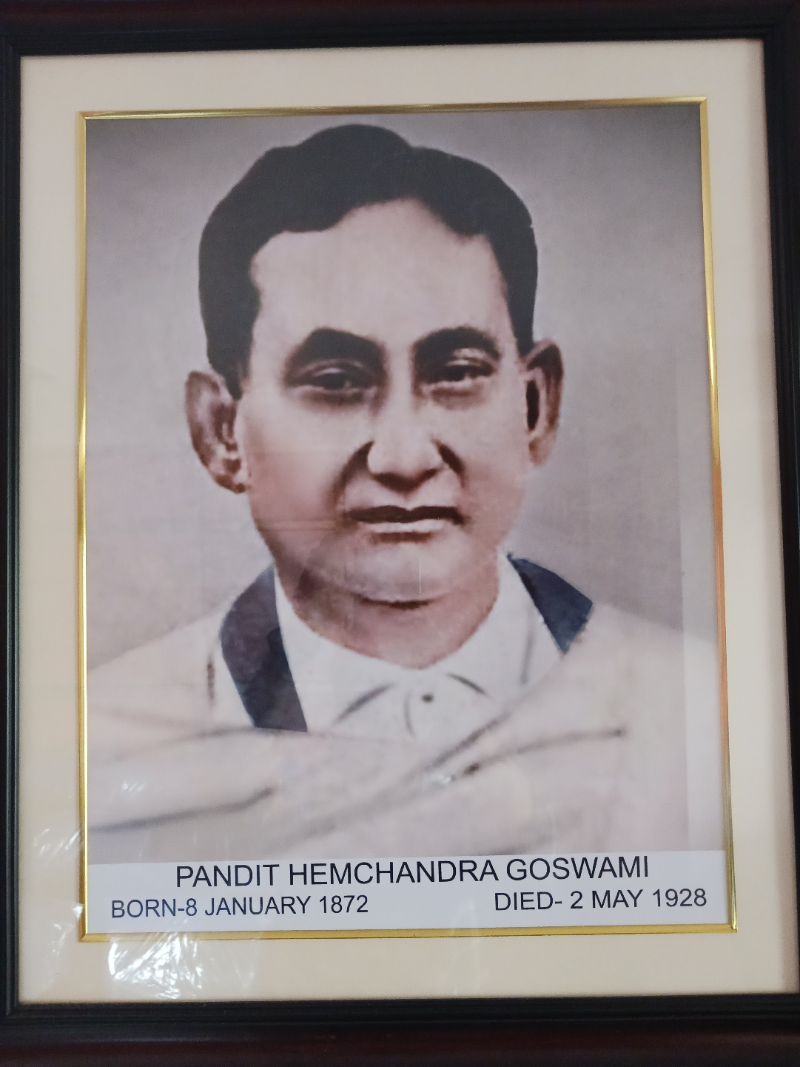
DEDICATION

Slide 2
Brief bio-sketch of Pt. Hemchandra Goswami
Born on January 8, 1872 at Gaurang Satra, Golaghat
Father: Srijut Dambrudhar Goswami, Mauzadar
Mother: Srijukta Ghanakanti Devi
Siblings: One brother, one sister
Father died at Benaras when Hemchandra was eight years old
Studied books like Amar-Kosh at home
At the age of 13, went to Nowgong for study, passed high school in 1888
Joined Presidency college in Kolkata, got involved in Assamese Language Improvement Society
Established that Assamese is not a dialect of any language but derived from Sanskrit
Wife: Srijukta Bamasundari Devi
Sons: Kriranchandra, Saratchandra, Prafullachandra (father of Dr. Naba Goswami), Tarunchandra
Daughters: Muktabala Devi, Hiraprabha Devi, Kamalkumari Devi

Slide 3
Professional life of Pt. Hemchandra
Worked as Head Master of Sonaram High School at Gauhati
Worked in the secretariat at Shillong
Based on his work on translation, came in the notice of local government
Appointed as Sub-Deputy Collector (without graduation) on May 17, 1897
Promoted to Extra Assistant Commissioner (Deputy Magistrate) at Gauhati on May 2, 1905
Transferred to Tezpur, worked with Rai Sahib Padmanath Gohain-Barua for Assamese literature
On special duty from October, 1912 to March, 1913 to work under the guidance of Col. Gurdon, the Honorary Provincial Director of Ethnography
Retired from Government service in February, 1925
Left for heavenly abode on May 2, 1928

Slide 4
Literary works of Pt. Hemchandra Goswami
First Assamese Composition at the age of 13: An article on Agriculture in Assam-Bandhu, February-March, 1885
Phular Chaki, 1907 (a book of poems)
Hemakosha, 1900 (Unpublished dictionary of Hemchandra Barua who died in 1897), Co-worker: Col. Gordon
Darrang-Raj-Vamsawali
Katha-Gita, 1918 (A sixteenth century book by Bhattadev)
Purani Asam Buranji, 1922 published by Kamrupa Anusandhan Samiti, introduction and editorial by Pt. Goswami. (Covers AD 1228−1696)
Katha-Bhagwata (A sixteenth century book by Bhattadev)
Publications in periodicals
Fourth President of Asam Sahitya Sabha in 1920 (Assam Sahitya Sabha was founded in December 1917. Dr. Surjya Hazarika is the present President.)

