Slide 1
Neural Imaging and Signal Systems
(BT 640)
Navin Gupta
Assistant Professor,
Dept of BSBE, IIT Guwahati
Email:cngupta@iitg.ernet.in
Few images are from Google

Slide 2
What do we know about Brain?
Orientations to Look at?
Any Idea?
Neural Imaging/Signal Systems, IIT Guwahati- Dr.Navin Gupta

Slide 3
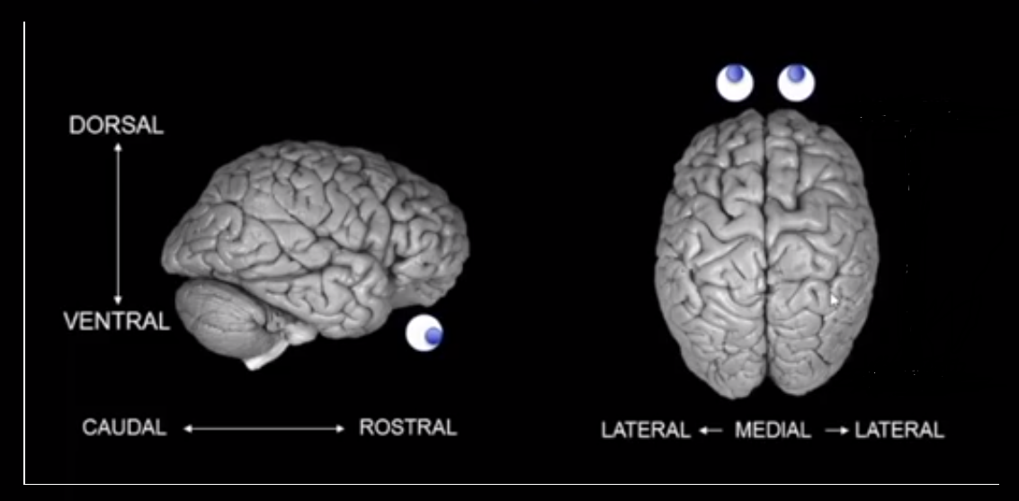
Orientations
Neural Imaging/Signal Systems, IIT Guwahati- Dr.Navin Gupta
Dorsal (Top), Ventral(Bottom); Rostral (Front), Caudal (Back)
Image from Dr.Marco Loggia Lecture, MGH Harvard

Slide 4
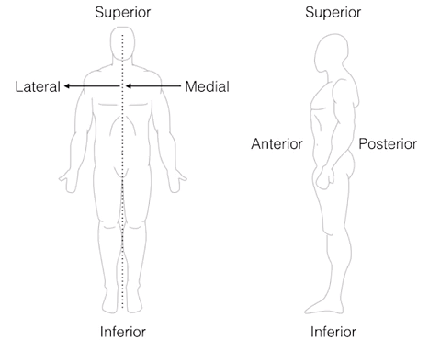
Orientations
Neural Imaging/Signal Systems, IIT Guwahati- Dr.Navin Gupta
Image from coursera lecture

Slide 5
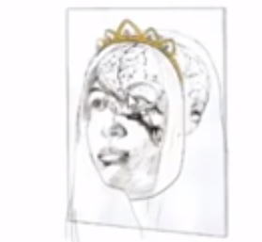
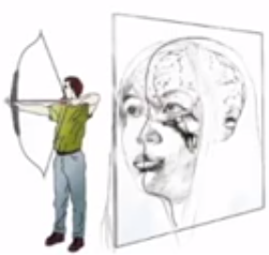
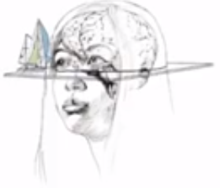
Orientations (Usually MRI)
Axial
Coronal
Saggital
Neural Imaging/Signal Systems, IIT Guwahati- Dr.Navin Gupta
Horizon
Crown
Bow of Arrow
Image from Dr.Kia Shahlaie Lecture, Univ of California @ Davis

Slide 6
Specialized cells in Brain. Any Idea?
Neural Imaging/Signal Systems, IIT Guwahati- Dr.Navin Gupta

Slide 7
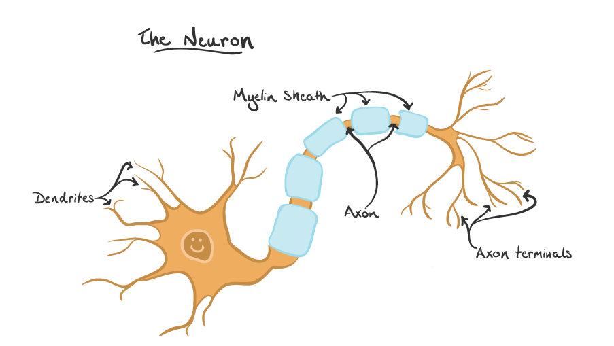
Cells in Brain
Brain consists of two types of specialized cells: Neurons & Glia
Neurons: Specialized type of cell for information transfer
Fire action potential (AP)
Structure of Neuron
Dendrites: Receive signals from neighboring neurons (like radio antenna).
Axon: Transmit Signals over a distance (like telephone wire)
Axon Terminal: Transmit Signals to other neuron dendrites (like a radio transmitter).
Myelin Sheath: Speeds up signal transmission along axon.
Neural Imaging/Signal Systems, IIT Guwahati- Dr.Navin Gupta
Image: cnx.org
Reference: https://qbi.uq.edu.au/brain/brain-anatomy/what-neuron

Slide 8
Types of Neurons?
Neural Imaging/Signal Systems, IIT Guwahati- Dr.Navin Gupta

Slide 9
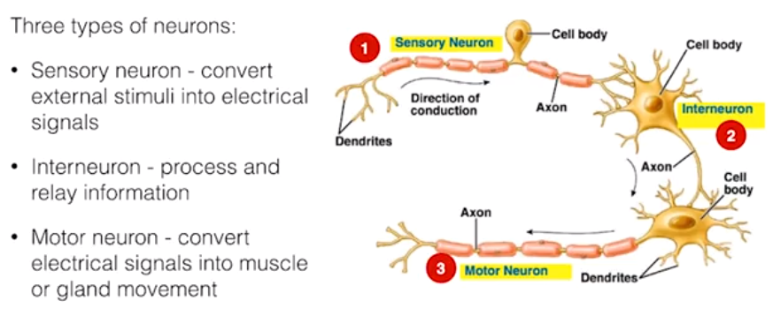
Neuron Types in Humans
Neural Imaging/Signal Systems, IIT Guwahati- Dr.Navin Gupta
Image from coursera lecture

Slide 10
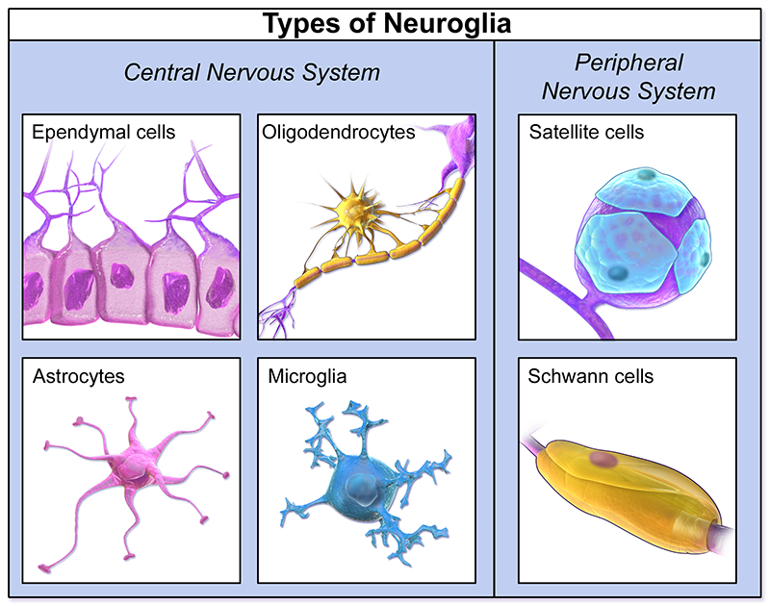
Cells in Brain
Second type of specialized cells
Glial Cells: Non-neuronal cells (i.e. Not nerves)
Do not fire AP (but view changing with research)
Produce myelin for axon/Remove neuronal secretions.
Neural Imaging/Signal Systems, IIT Guwahati- Dr.Navin Gupta
Reference: https://qbi.uq.edu.au/brain/brain-anatomy/what-neuron

Slide 11
Regions of Brain. Any Idea?
Neural Imaging/Signal Systems, IIT Guwahati- Dr.Navin Gupta

Slide 12
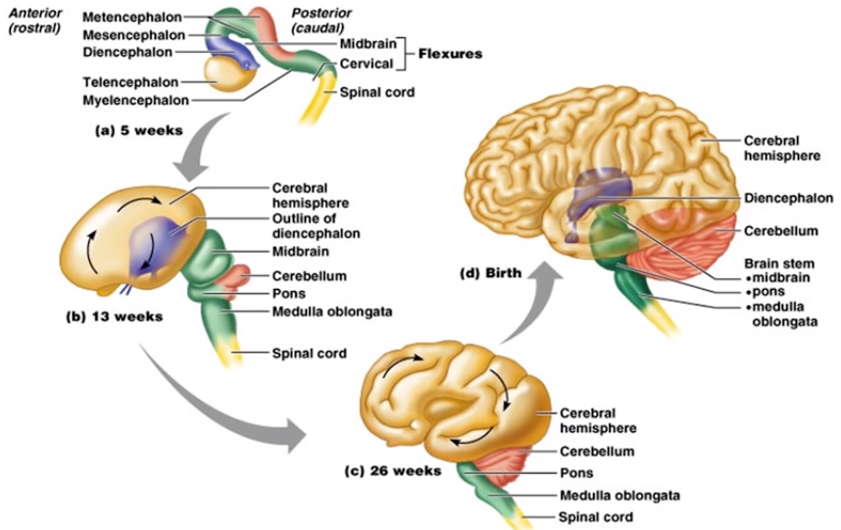
Embryonic Development of Brain
Neural Imaging/Signal Systems, IIT Guwahati- Dr.Navin Gupta
Image from Dr.Kia Shahlaie Lecture, Univ of California @ Davis

Slide 13
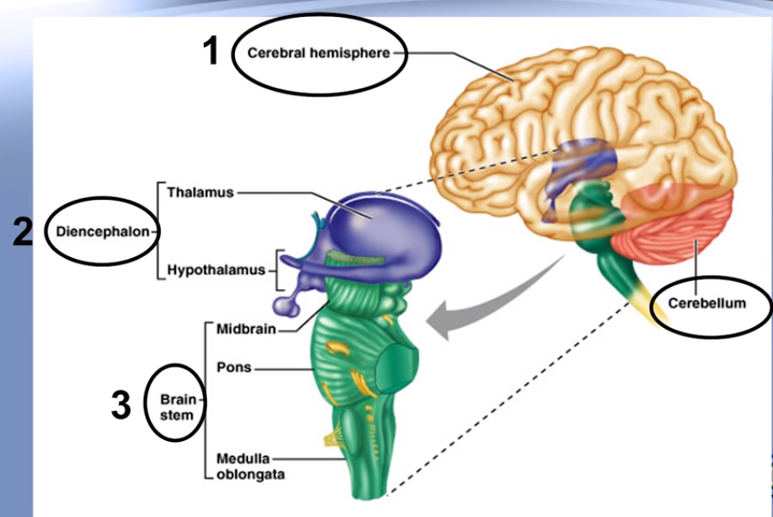
Regions of Brain at Birth
Neural Imaging/Signal Systems, IIT Guwahati- Dr.Navin Gupta
Image from Dr.Kia Shahlaie Lecture, Univ of California @ Davis

Slide 14
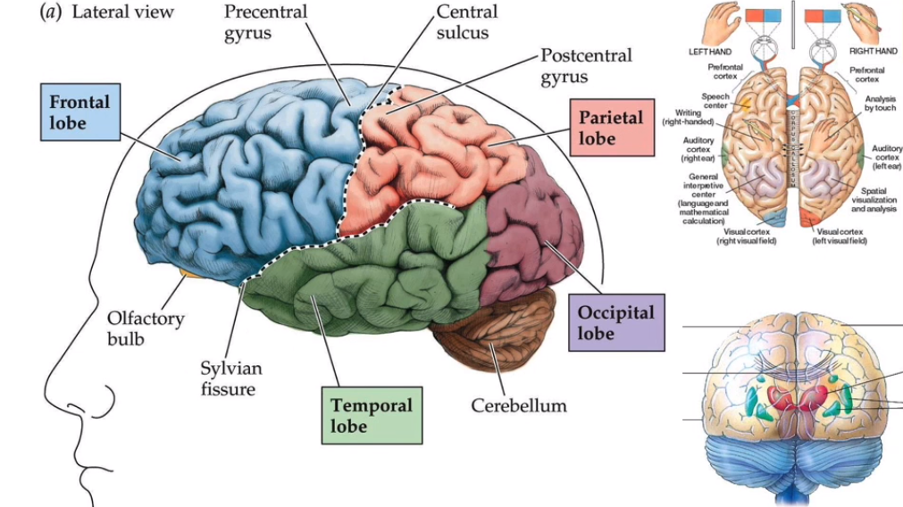
Lobes/Fissures of Brain
Neural Imaging/Signal Systems, IIT Guwahati- Dr.Navin Gupta
Image from Dr.Octavio Choi Lecture
Oregon Health and Sciences University
Corpus Callosum bridge connects two
halfs of the brain

Slide 15
Function of Gyri (bumps)/Sulci (valley)
Neural Imaging/Signal Systems, IIT Guwahati- Dr.Navin Gupta

Slide 16
Cerebral Hemispheres
Neural Imaging/Signal Systems, IIT Guwahati- Dr.Navin Gupta
Gyri/Sulci
Image from Dr.Kia Shahlaie Lecture, Univ of California @ Davis

Slide 17
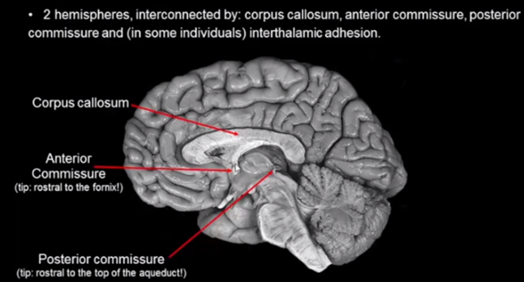
Cerebral Hemispheres
Neural Imaging/Signal Systems, IIT Guwahati- Dr.Navin Gupta
Image from Textbook (Neuroscience, Claudia Krebs)

Slide 18
What are Broadmann Areas of Brain?
Neural Imaging/Signal Systems, IIT Guwahati- Dr.Navin Gupta

Slide 19
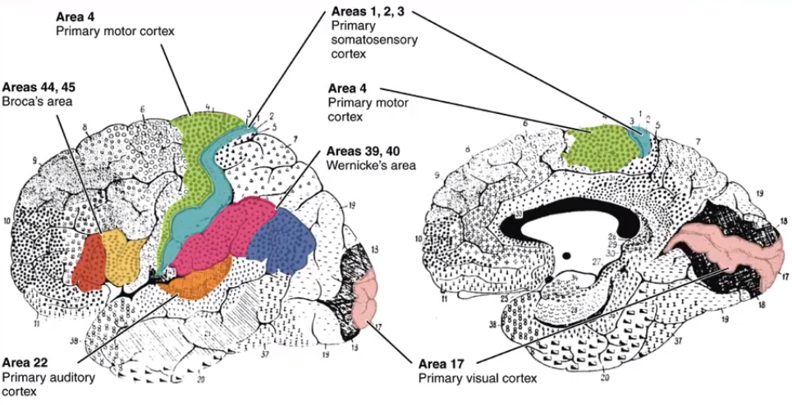
Broadmann Areas
1)Looked at regions of brain under a microscope.
2)Classified into sub regions based on cell types.
3)Report Neuroimaging findings
Neural Imaging/Signal Systems, IIT Guwahati- Dr.Navin Gupta
Image from Dr. Octavio Choi Lecture
Oregon Health and Sciences University

Slide 20
Functional Classification of Brain Areas
Neural Imaging/Signal Systems, IIT Guwahati- Dr.Navin Gupta

Slide 21
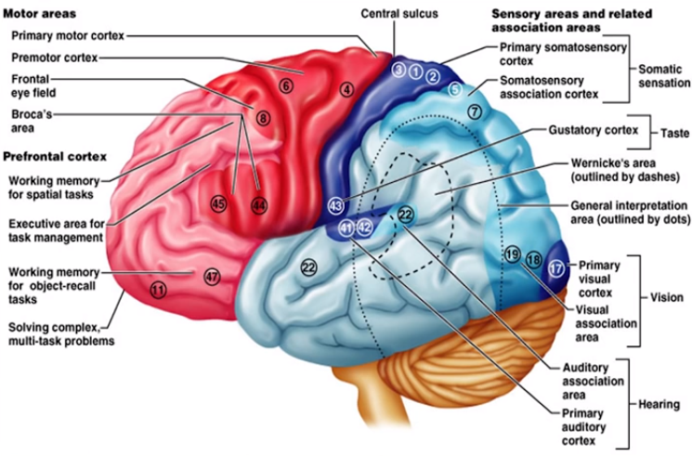
Functional Anatomy of Brain Regions
Neural Imaging/Signal Systems, IIT Guwahati- Dr.Navin Gupta
Prefrontal cortex Sensory Areas
Motor Areas Association areas
Image from Dr.Kia Shahlaie Lecture, Univ of California @ Davis

Slide 22
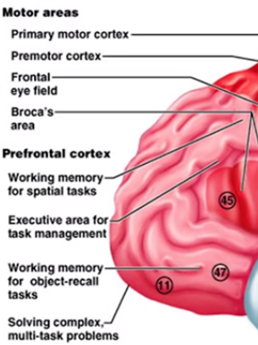
Functional Anatomy of Brain (Prefrontal Cortex)
Neural Imaging/Signal Systems, IIT Guwahati- Dr.Navin Gupta
Image from Dr.Kia Shahlaie Lecture, Univ of California @ Davis

Slide 23
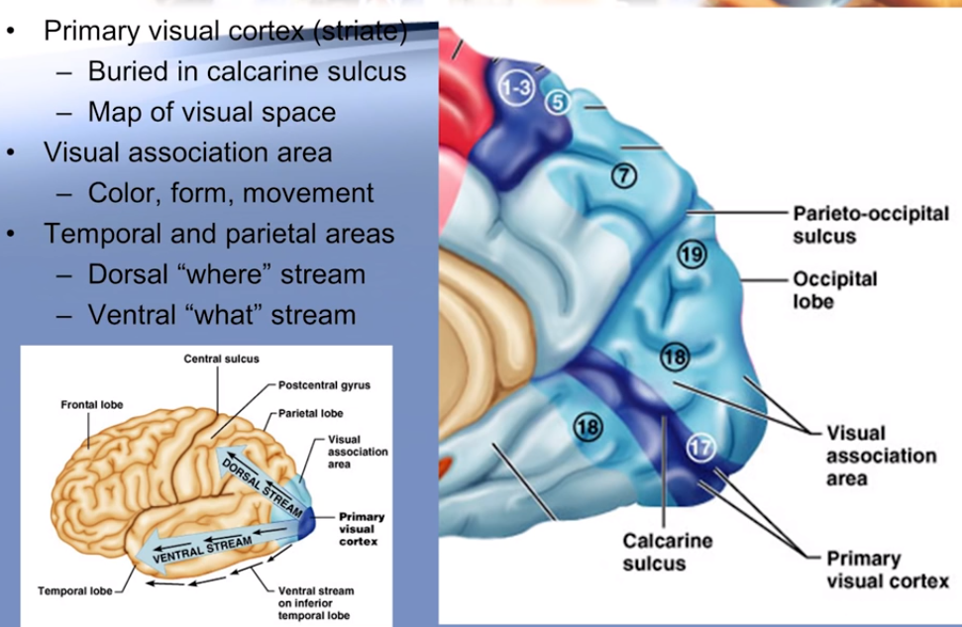
Functional Anatomy of Brain
(Visual Areas)
Neural Imaging/Signal Systems, IIT Guwahati- Dr.Navin Gupta
Image from Dr.Kia Shahlaie Lecture, Univ of California @ Davis

Slide 24
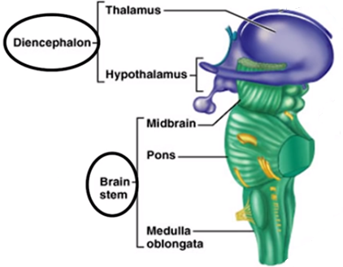
Functional Anatomy of Brain
(Diencephalon and Brainstem)
Limbic System
(Core Evaluations of external and internal environment)
Neural Imaging/Signal Systems, IIT Guwahati- Dr.Navin Gupta
Basic Life support like respiration, heart rate
Image from Dr.Kia Shahlaie Lecture, Univ of California @ Davis

Slide 25
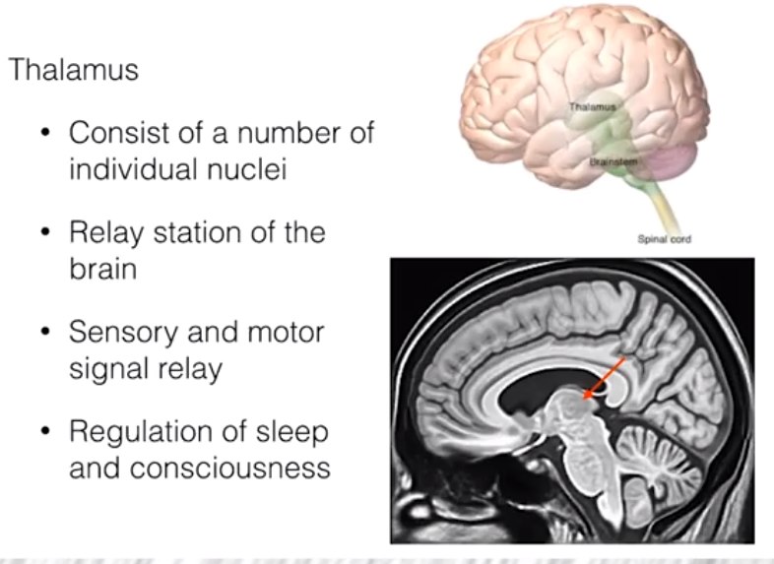
Functional Anatomy of Brain
(Thalamus)
Neural Imaging/Signal Systems, IIT Guwahati- Dr.Navin Gupta
Image from coursera lecture

Slide 26
What is the function of Cerebellum?
Neural Imaging/Signal Systems, IIT Guwahati- Dr.Navin Gupta

Slide 27
Functional Anatomy of Brain
(Cerebellum)
Neural Imaging/Signal Systems, IIT Guwahati- Dr.Navin Gupta
Image from Dr.Kia Shahlaie Lecture, Univ of California @ Davis

Slide 28
Is Plasticity of Brain true?
Neural Imaging/Signal Systems, IIT Guwahati- Dr.Navin Gupta

Slide 29
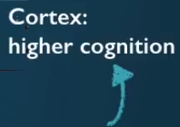
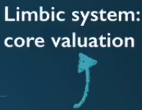
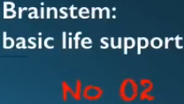
Brain is Hierarchically organized
Neural Imaging/Signal Systems, IIT Guwahati- Dr.Navin Gupta
Textbook (Neuroscience, Claudia Krebs)

Slide 30
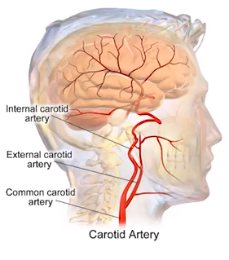
VASCULAR ANATOMY OF BRAIN
Brain consumes tremendous amount of energy and oxygen is supplied by an intricate system of arteries and veins.
Internal carotid artery supplied blood to brain.
Image from coursera lecture

Slide 31
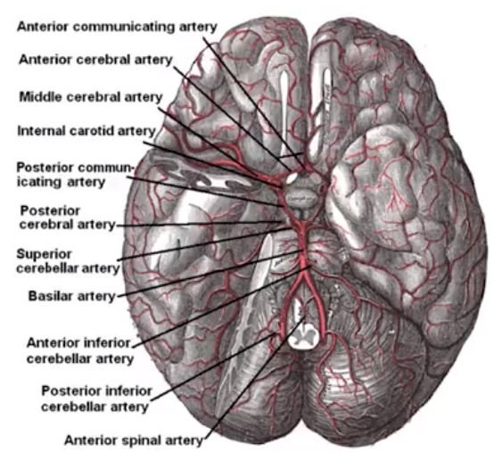
VASCULAR ANATOMY OF BRAIN
Arteries supplying blood to brain
Image from coursera lecture

Slide 32
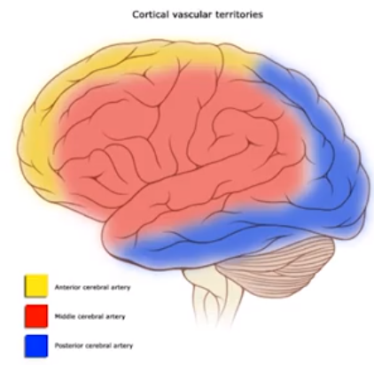
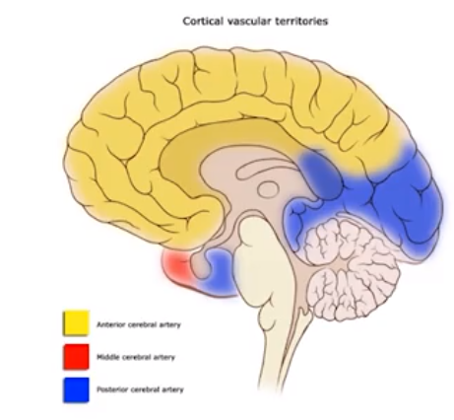
VASCULAR TERRITORIES OF BRAIN
Each Artery supplies blood to a specific brain area.
Image from coursera lecture

Slide 33
Any Questions?
Thanks for Coming ☺

